Slide 1

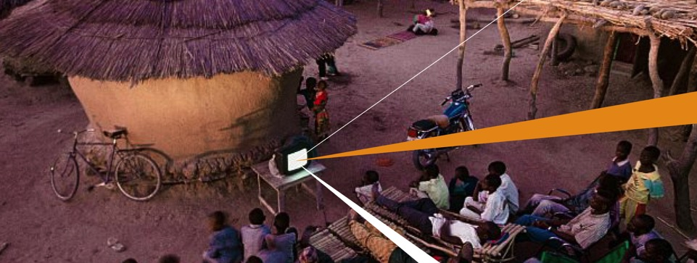
Efficiency for Access Design Challenge
Webinar: Gender and Social Inclusion
December 2019

Slide 2

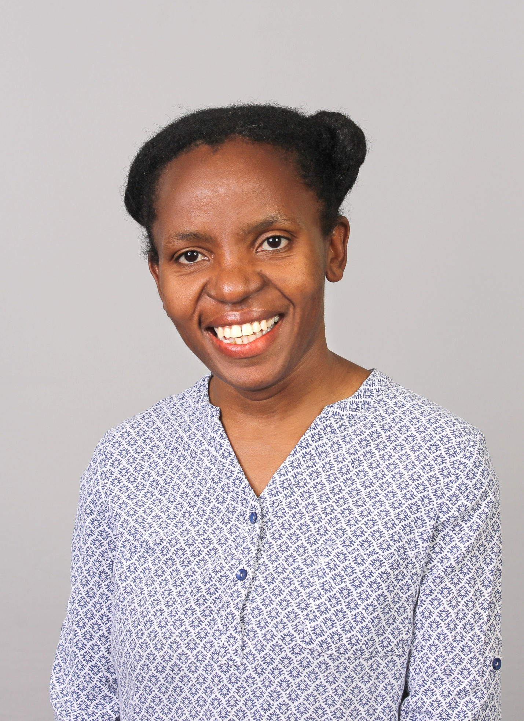

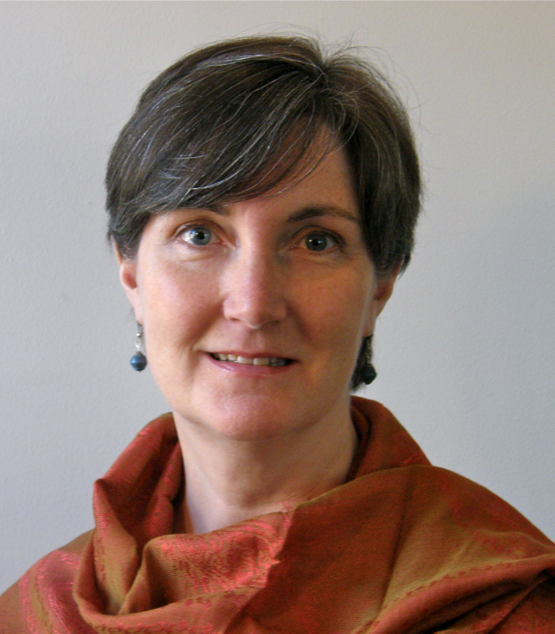
Dr. Margaret Matinga
  Expert modern cleaner energy access across Africa and Asia
  Delivered projects for clients such as the AfDB, UNDP, UNECA, the World Bank, the EU, various international NGOs, and lectured at the University of Twente Board member of the Uganda Solar Energy Association (USEA)
  BSc in Mechanical Engineering from the University of Malawi, an MSc Eng in Energy Studies from the University of Cape Town and a PhD from the University of Twente
  Dr. Jon Cloke
  National Network Manager for the UK Low Carbon Energy for Development Network and as Senior Research Associate at Loughborough University
  Worked on a variety of DfID-funded projects including Understanding Sustainable Energy Solutions (USES) and Transforming Energy Access (TEA)
  lecturer in human geography in the Geography Department at Loughborough from 2007 to date and worked as an NGO Consultant to different non-government organizations
Katherine Lucey
  Founder and Chief Executive Officer of Solar Sister, an innovative last mile distribution solution for clean energy technologies in rural Africa that taps into the power of women entrepreneurs
  Schwab Foundation Entrepreneur of the Year, an Ashoka Fellow, and a Draper Richards Kaplan Foundation Entrepreneur
  M.B.A. from Georgia State University and a Bachelor’s Degree in Journalism from the University of Georgia

Slide 3
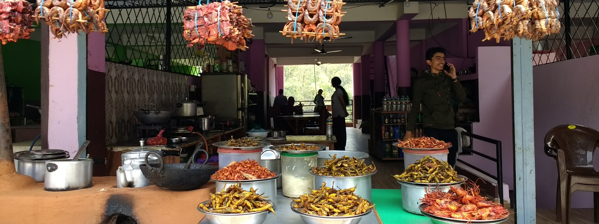
Leaving no one behind: A gender perspective
Margaret Matinga, Dunamai

Slide 4
Why gender and energy
Women and men’s needs differ. But design and policy has traditionally had a gender-blind approach
Women tend to have less economic and decisionmaking power affecting appliances they can access and use
Lower levels of technical capacity means fewer women in technology design and thus their voice is often silent. Also lower capacity to affect policy making
Title of presentation

Slide 5
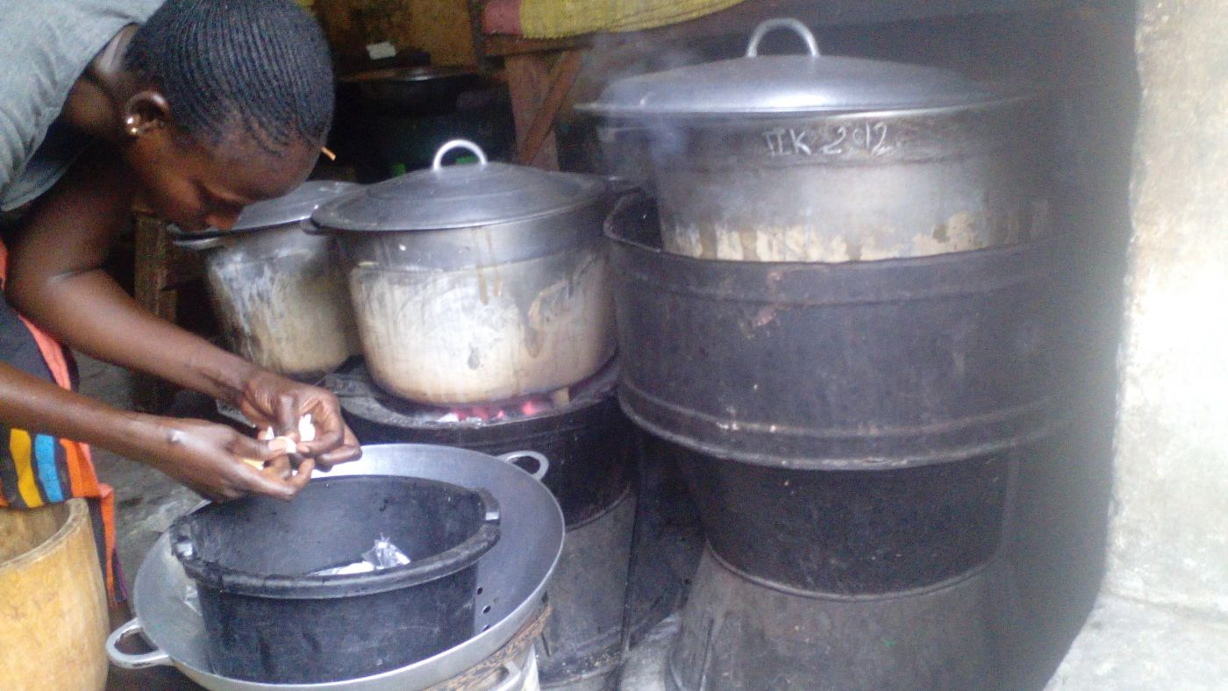
Forgetting women’s complex needs
Being driven by single-issue focus and not needs
  While general narrative calls for transition from open fire cooking, for some dishes, women (and men) needed this to impart particular flavour desired by customers),
  Ceremonial cooking
Reducing women’s energy needs to cooking for family
Title of presentation

Slide 6
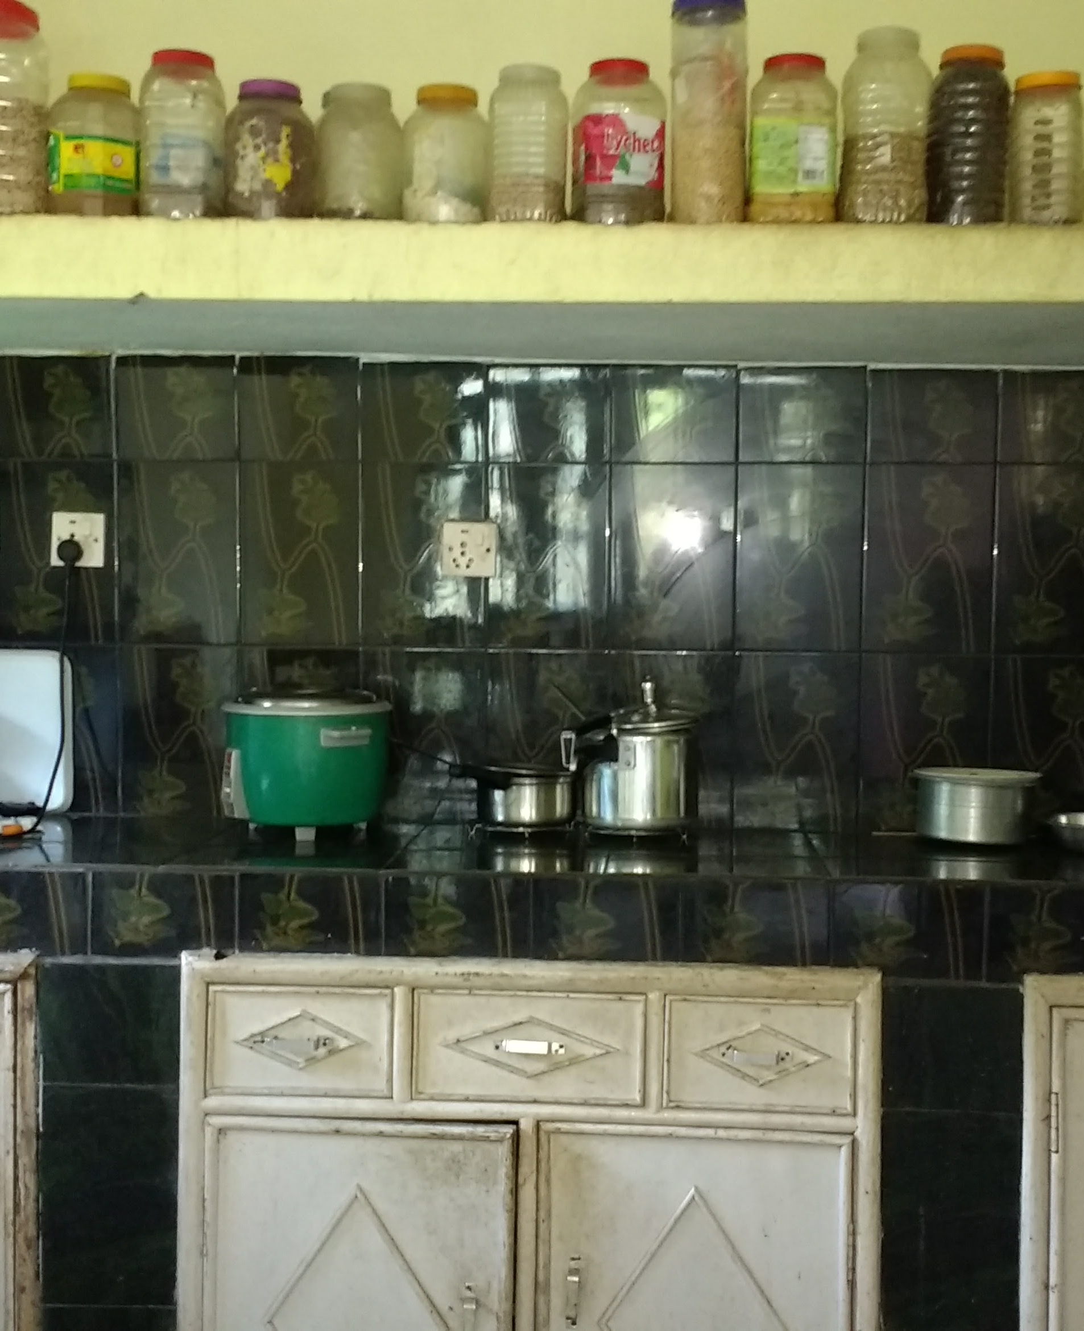
Is small always beautiful?
Most gender-sensitive or responsive design focus on low capacity systems
Study of systems and their impact on women’s empowerment in Nepal showed low capacity systems yielded lower benefits for women than high capacity systems
With high capacity, women saved time by using rice cookers, blenders, mills
Affordability vs needs
Title of presentation

Slide 7
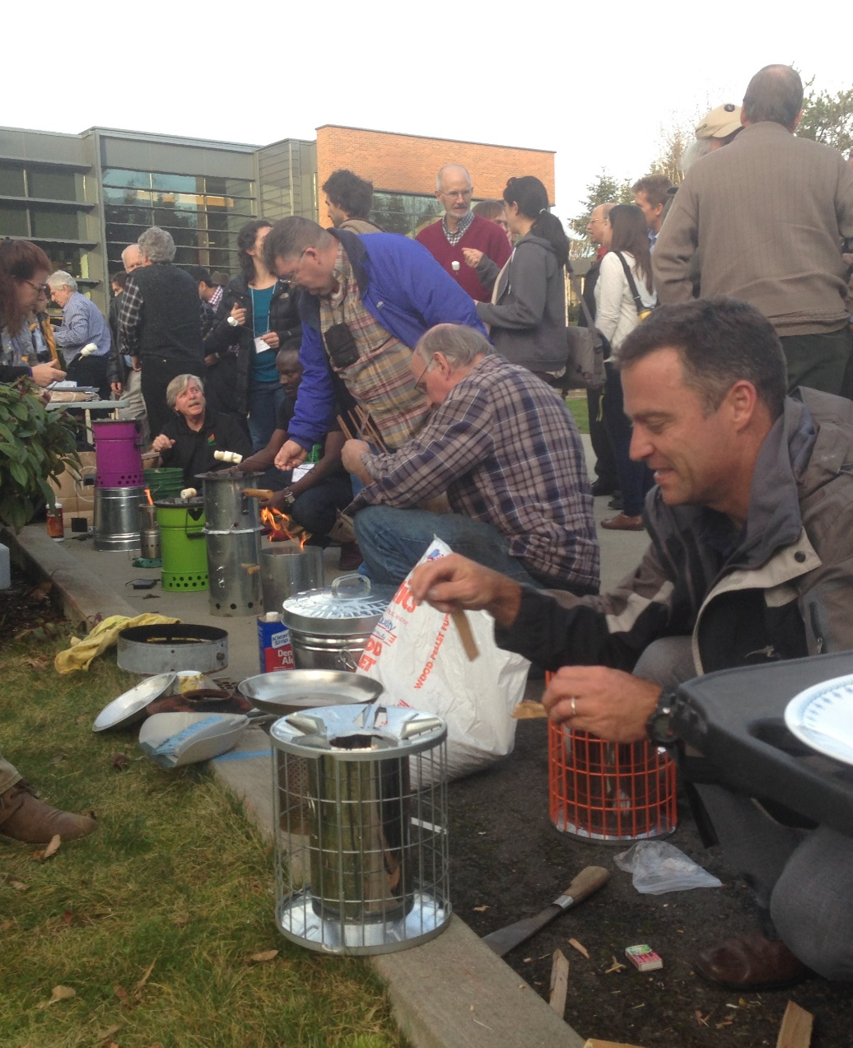
Technical performance is not everything
Assessment of 5 stoves in a refugee camp showed that the most technically efficient stove was the least preferred
Some high performance systems do not suit user needs
Required to much attendance time, added to women’s work burdens
Title of presentation

Slide 8
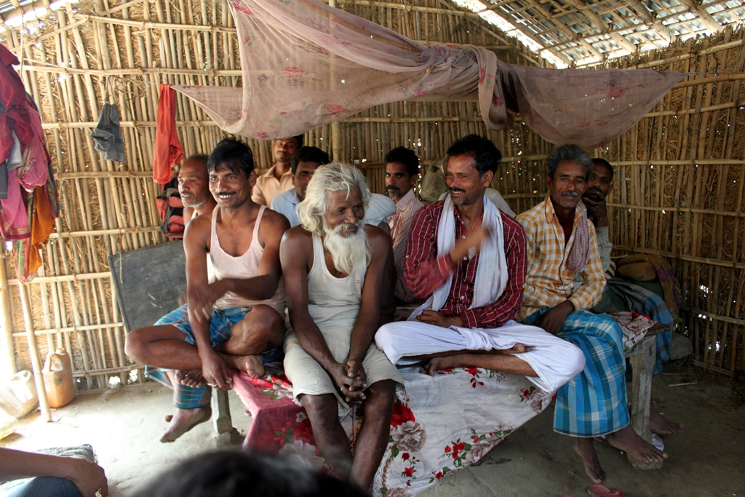
Forgetting context and underlying factors
Power relations are often forgotten in design of appliances
A thermogenerator cookstove is a great idea. But who is likely to have smart phones to charge? How does that affect women’s use of the cookstove or demand for firewood?
Cost of technology might affect who has overall decision making power
Similarly, without supportive transformative measures, who is likely to benefit from solar irrigation? Who looses out?
  Consider what other allied resources and ownership or power patterns
Title of presentation

Slide 9
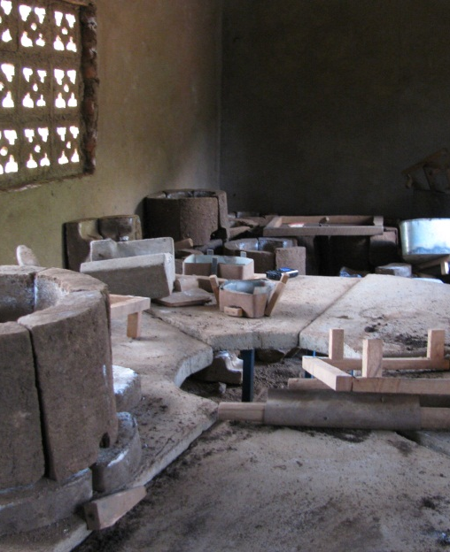
Involving women in supply chains is more than production and sales
How friendly is the product to local assembly? Peer2peer sales etc
Women’s businesses need more than financing and involvement in production and sales
  Warehousing
  Transportation
  Connection to markets
  Support for changing norms e.g. regarding women travelling outside the village
Considering women’s “non development” priorities
Title of presentation

Slide 10
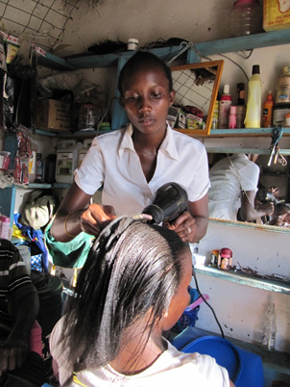
Not all women are the same
It is ok to design for non-poor women! Really!
Title of presentation

Slide 11
Contact
Magi Matinga
Mmat_001@yahoo.com
Title of presentation

Slide 12

Any questions?

Slide 13

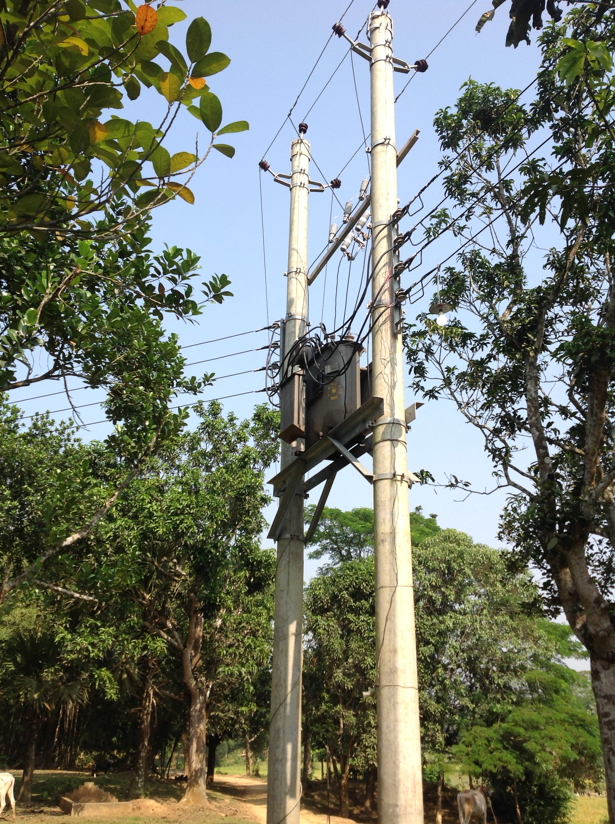
‘MERE’ ELECTRIFICATION: Design Challenge Webinar on Gender Perspectives
Dr Jon Cloke, Low Carbon Energy for Development Network (www.lcedn.com)

Slide 14

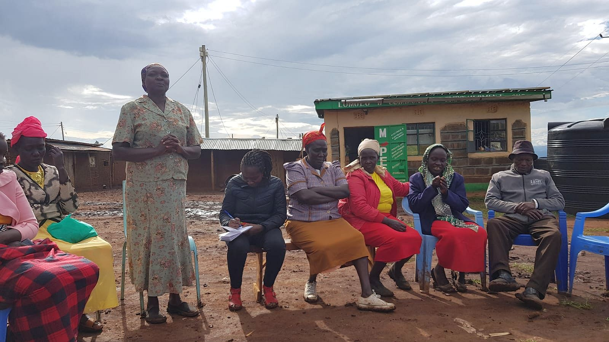
Community Energy Projects are more than technology..
THE LEMOLO B VILLAGE ENERGY COMMITTEE

Slide 15
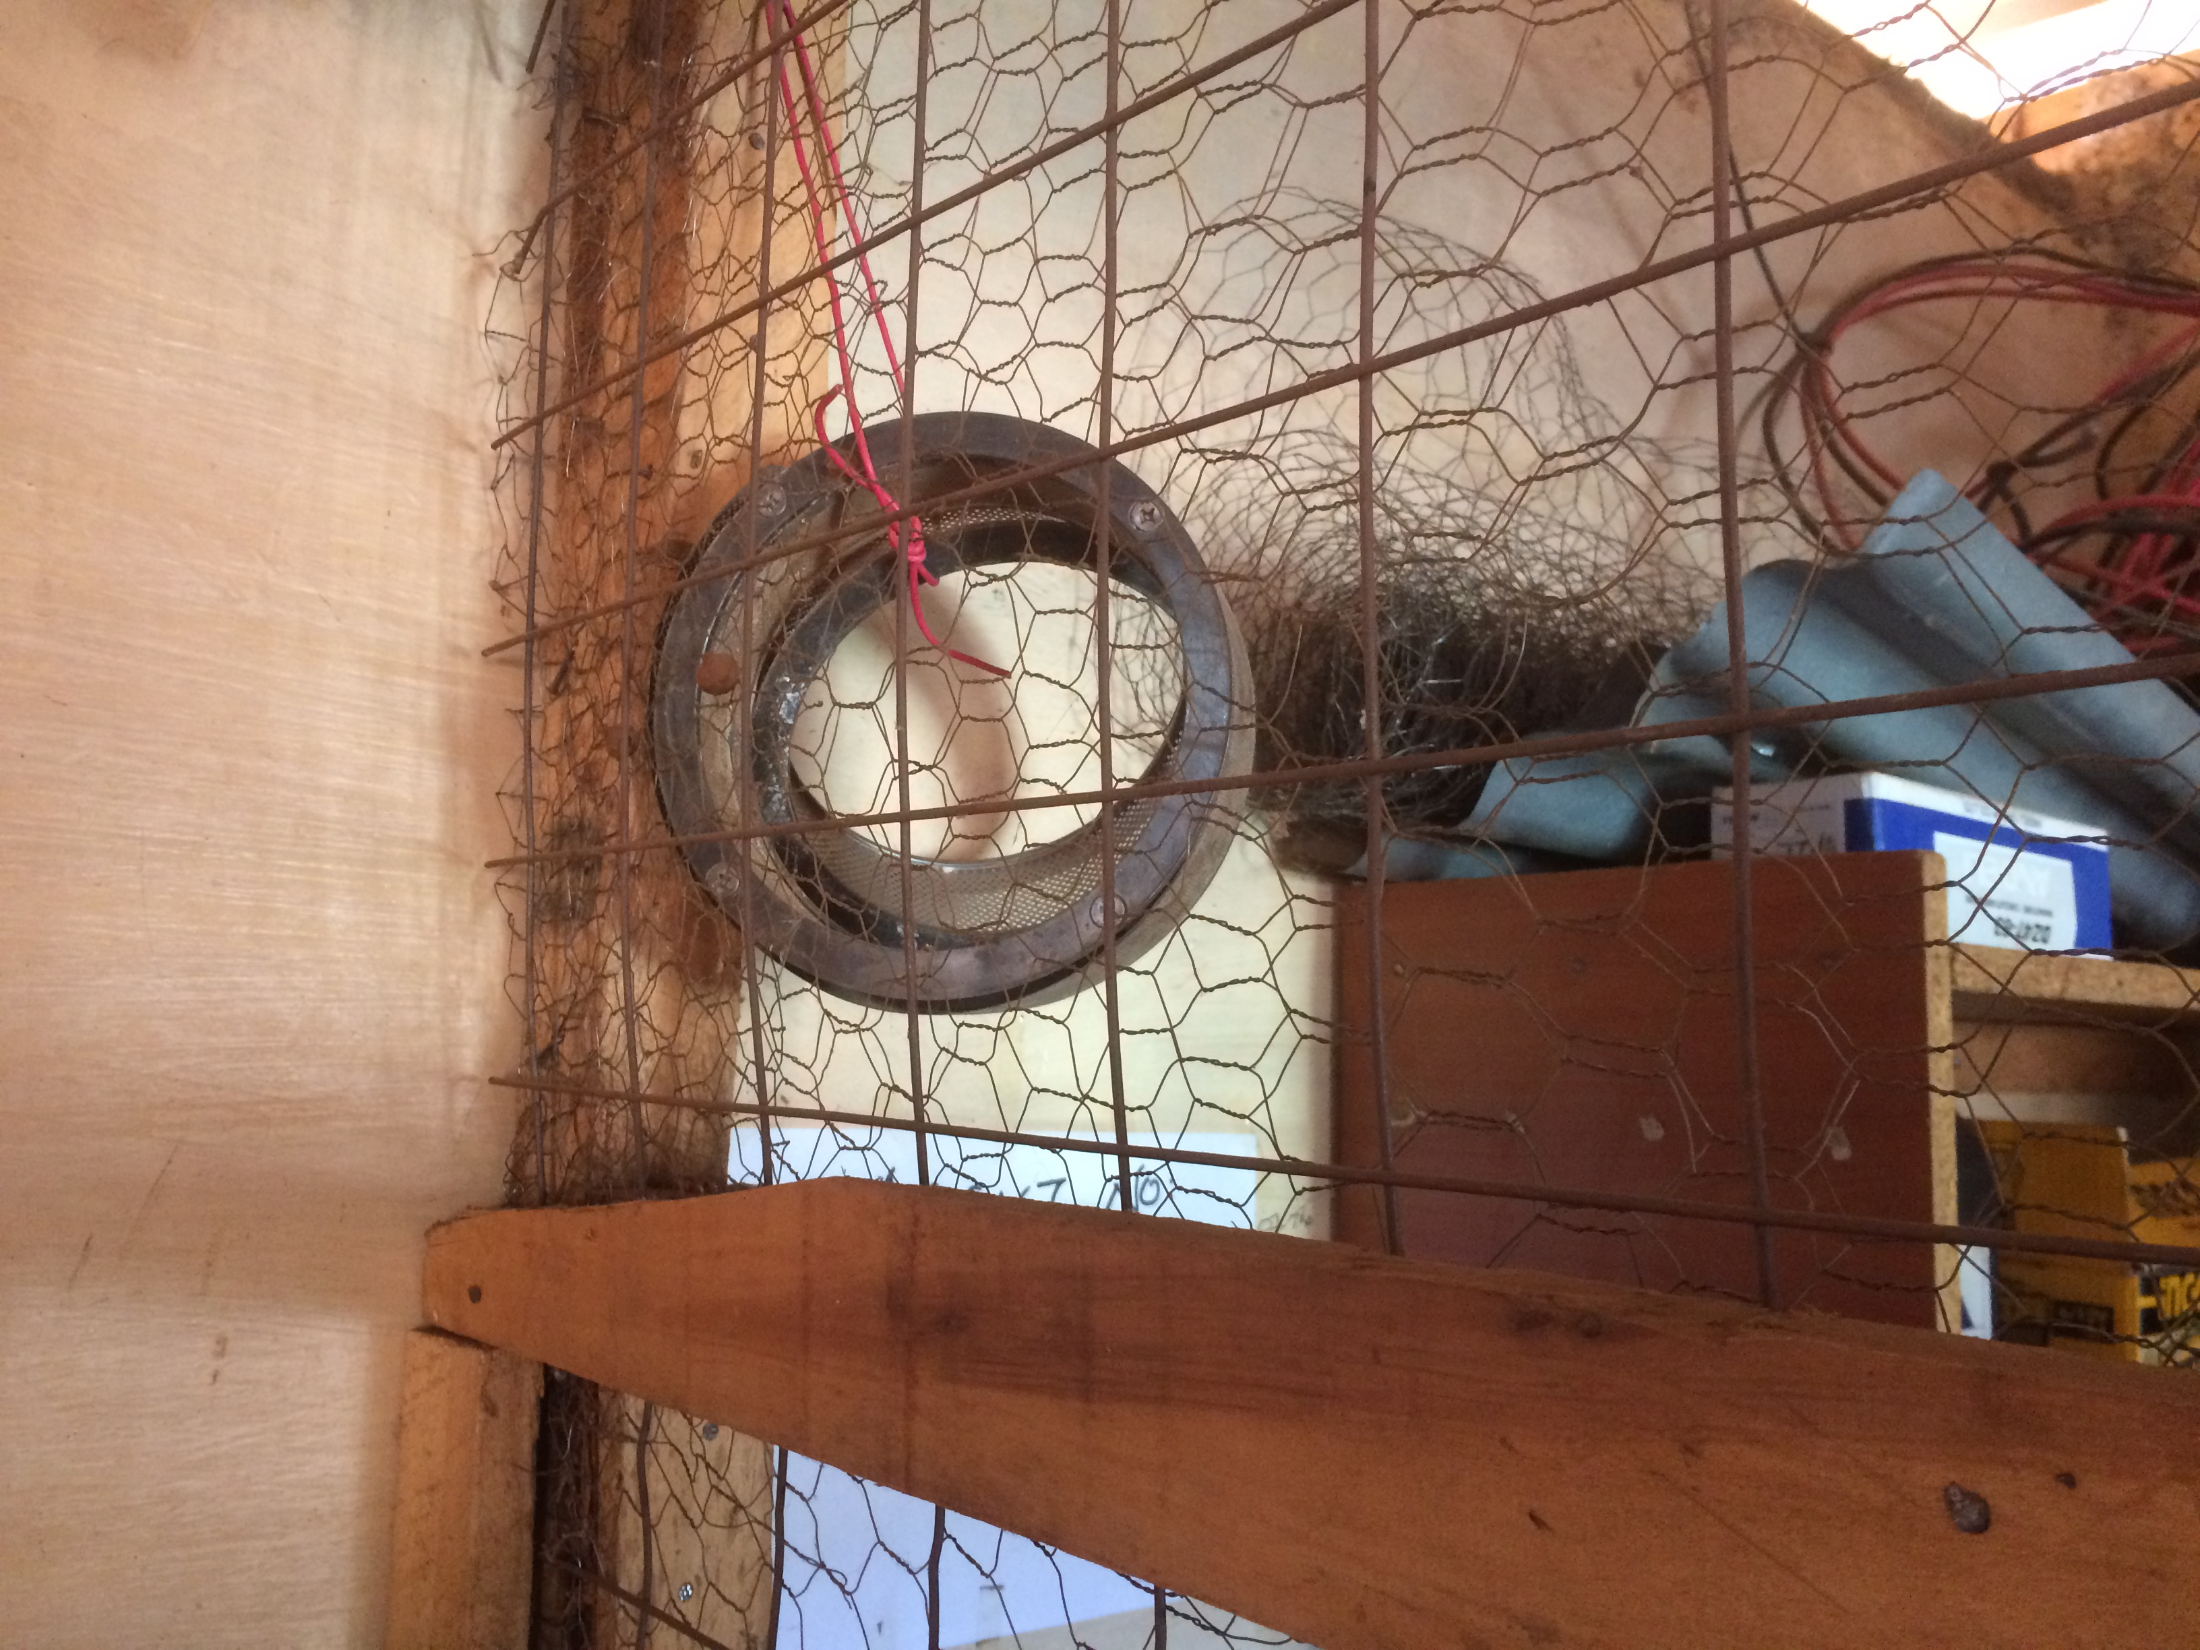
Problems with technology-focused interventions –
Projects with a top-down technologically-driven framework
Projects are frequently reverse-engineered through focus combinations of technologies, financial models and delivery mechanisms
Projects not looking at the particular energy needs/aspirations of individuals/communities
Assumptions over the association between energy access and livelihood enhancement
There is no necessary causation between scaleability and outcomes
Cloke, J., Mohr, A. and Brown, E. (2017) Imagining renewable energy: Towards a Social Energy Systems approach to community renewable energy projects in the Global South, Energy Research & Social Science, ER&SS

Slide 16
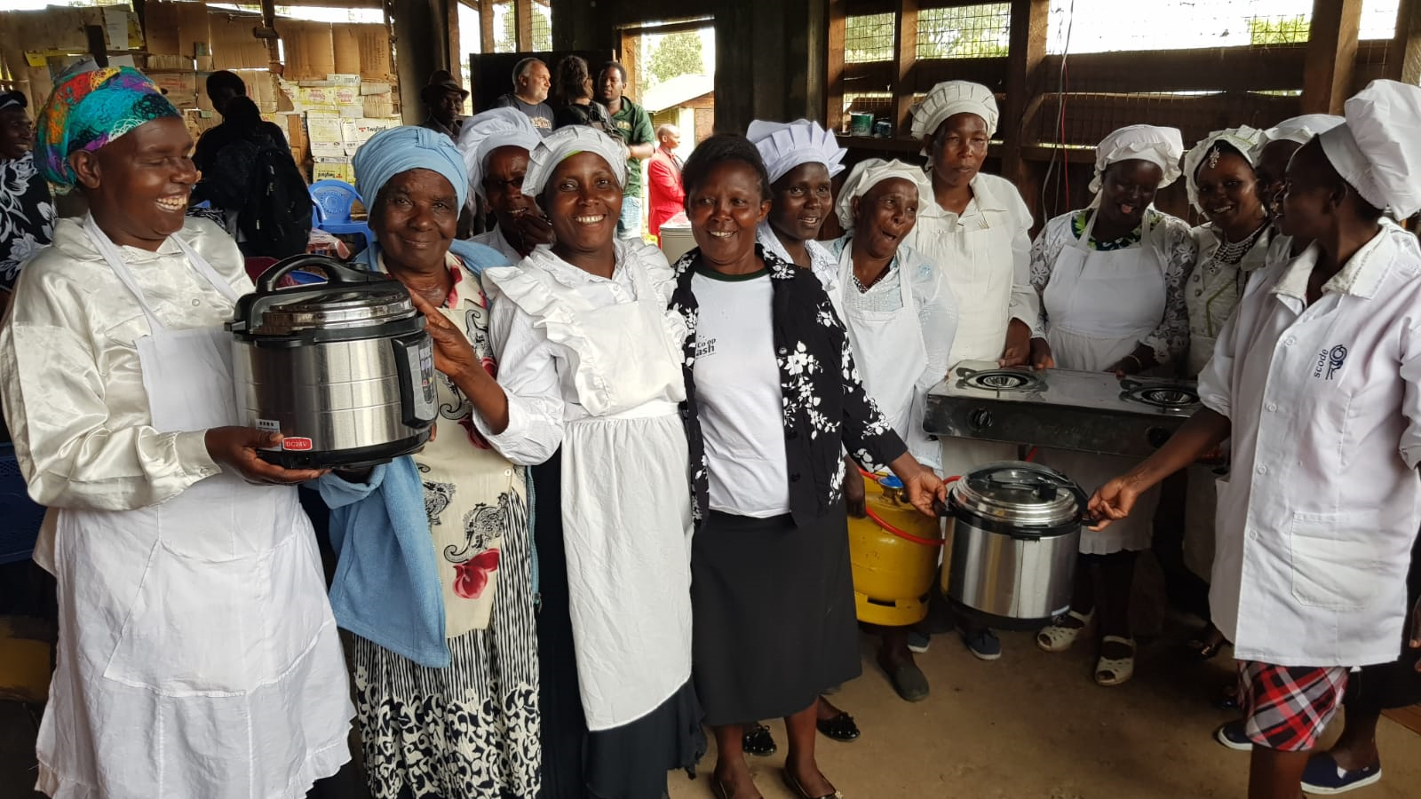
All you need is Community ownership?
SETTING UP SOLAR NANOGRIDS IN KENYA:
Exhausting process of community consultation to work out energy needs, wants and aspirations.
Presenting data to the community from consultations, interviews, focus group discussions – what they told the team about their lives and their priorities.
Presenting basic ideas for the energy system designed from community responses, divided into three elements: HOUSEHOLD, COMMUNITY and BUSINESS.
Setting up an elected Village Energy Committee (VEC) officially registered with local government authorities
The introduction of the idea of a Community Fund as a feature of the energy project.

Slide 17
“You will need to design an appliance for people…” (Efficiency for Access Design Challenge Challenge Brief P.6)

Slide 18
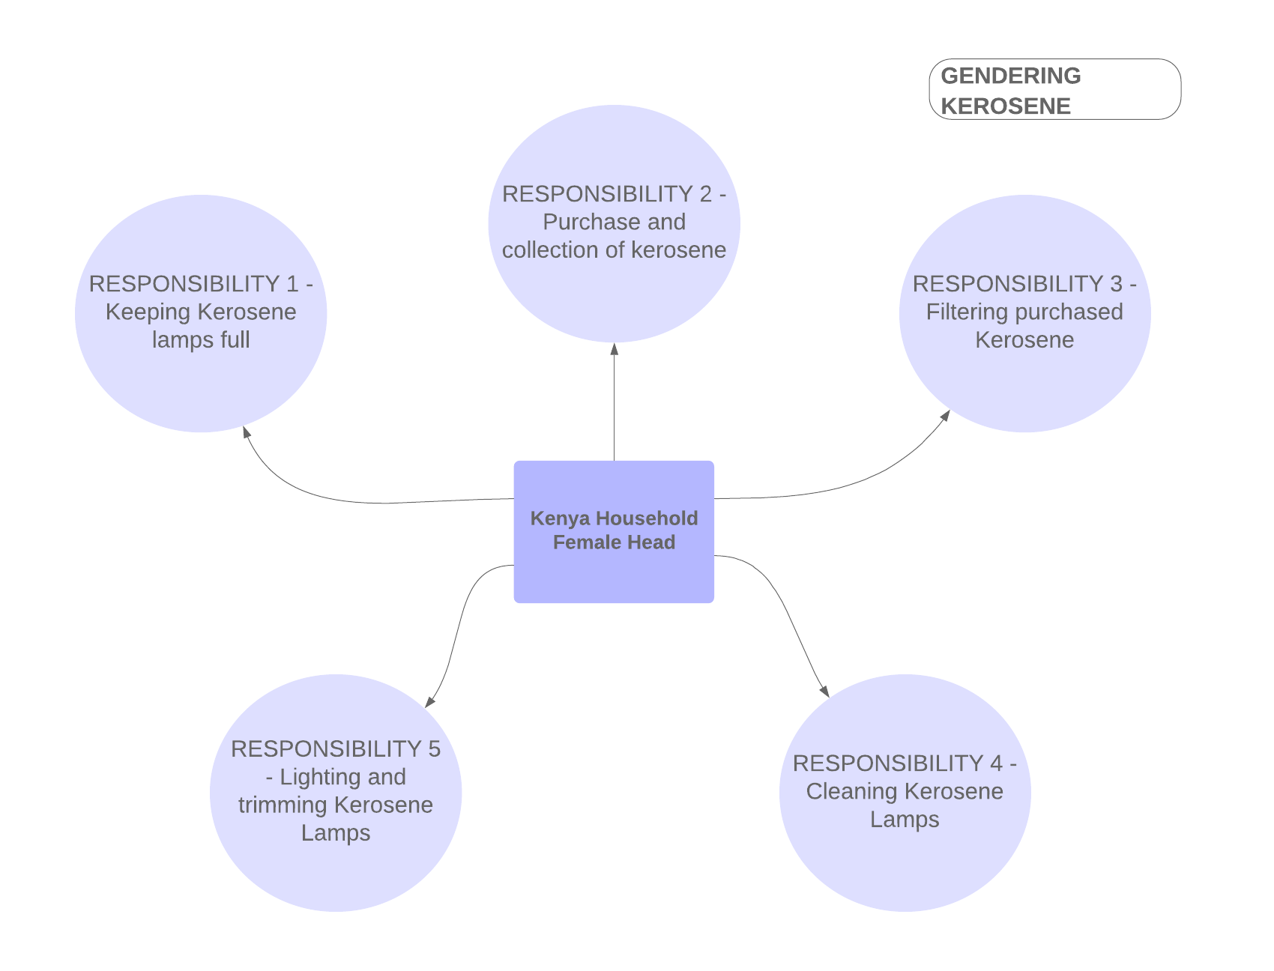

Slide 19

Towards a Social Energy Systems Approach….
“it is the social scale via which optimum forms of local participation and ownership can be achieved.”
BECAUSE:
“While there is a wealth of empirical evidence to suggest that projects often achieve developmental benefits in terms of health, education, security and social integration to varying degrees, the degree to which RET projects address the poverty of household members and their ability to generate income is less clear. In fact, evidence suggests that they do not and in some cases actually impose additional financial burdens.”

Slide 20
Any questions?

Slide 21

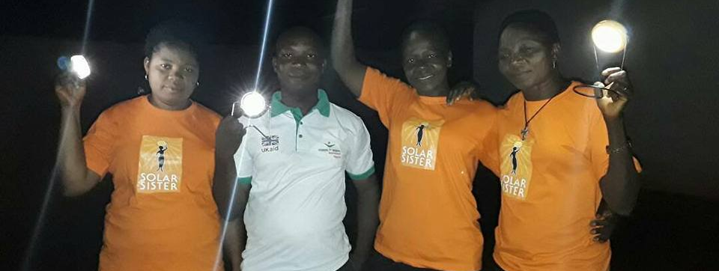
Solar Sister – Women Powered Impact
Katherine Lucey

Slide 22
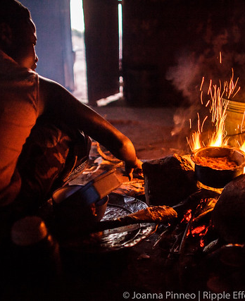
The Problem
600 million people in sub-Saharan Africa without access to electricity
Women and girls are particularly impacted
Lack of electricity means no lights at night to care for family, cooking over open fires, using kerosene lamps for lights
Impacts on health, safety, education, productivity, general wellbeing

Slide 23
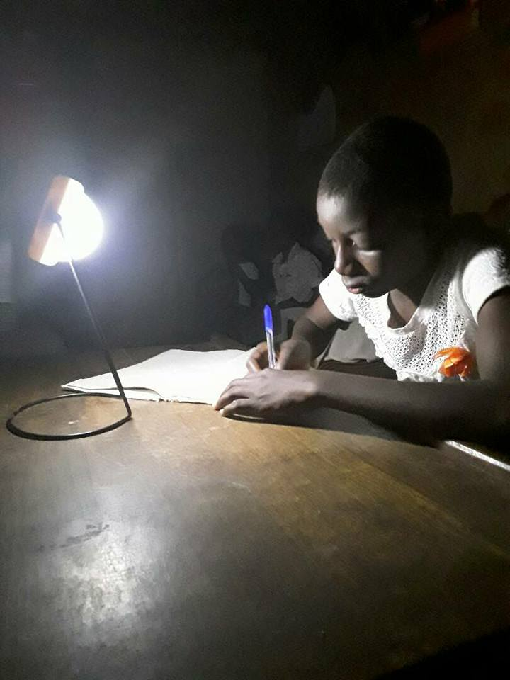
Local Solution
Technology exists that is appropriate and affordable
Solar lights can be used in the most remote locations and enhance lives – providing light for education, improving health, productivity and well being
Distributed off-grid solar technology can be used for generating energy for lighting, phone charging, productive use appliances
The technology is not the issue - so what is the issue?

Slide 24
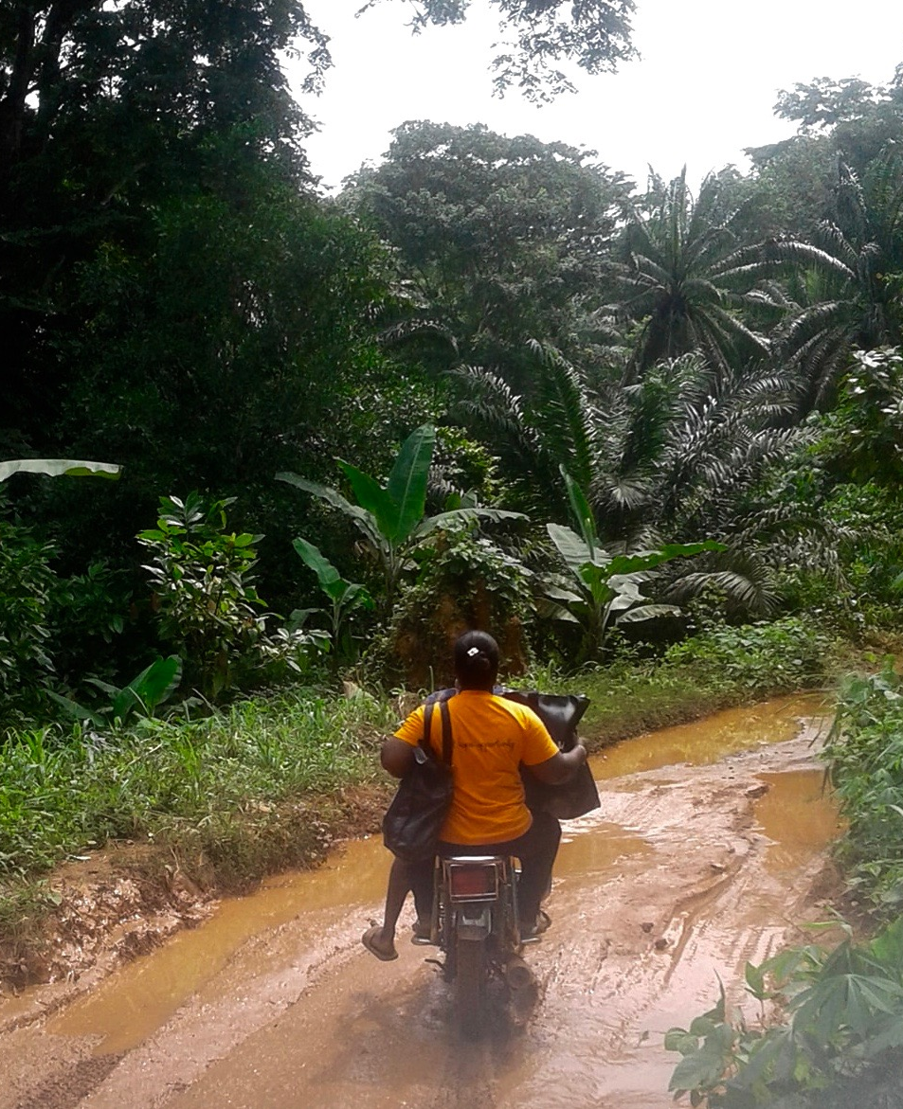
Solving the Last Mile
Getting products delivered to the ‘Last Mile’
”Last Mile’ is defined as remote, underserved, hard to reach, lacking in economic resources – essentially all the qualities that make this market difficult and uneconomic to serve
Recruiting local women to become the distribution network anchors the solution in the community and builds off of their deep social networks

Slide 25
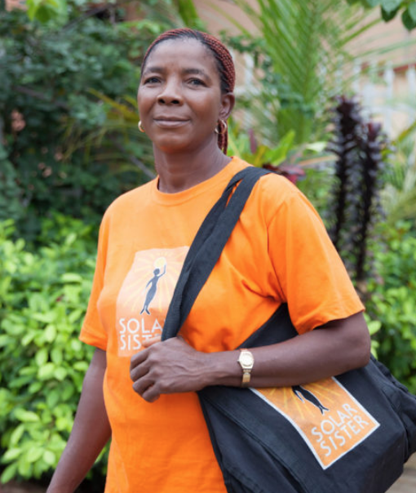
Solar Sister’s Approach
Recruit, train, support local women to be clean energy entrepreneurs
Provide key tools to start a business in a branded bag
Curated, certified quality products
Local delivery
Marketing support
Aftermarket support including repair and warranty

Slide 26
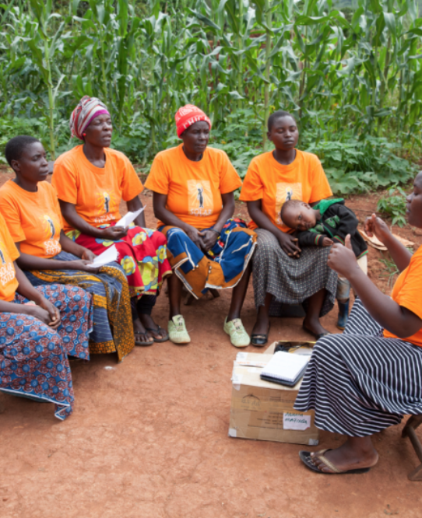
Solar Sister’s Approach
Training
  Technology
  Business
  Empowerment
Mentoring
Peer support in “Sisterhood Groups”

Slide 27
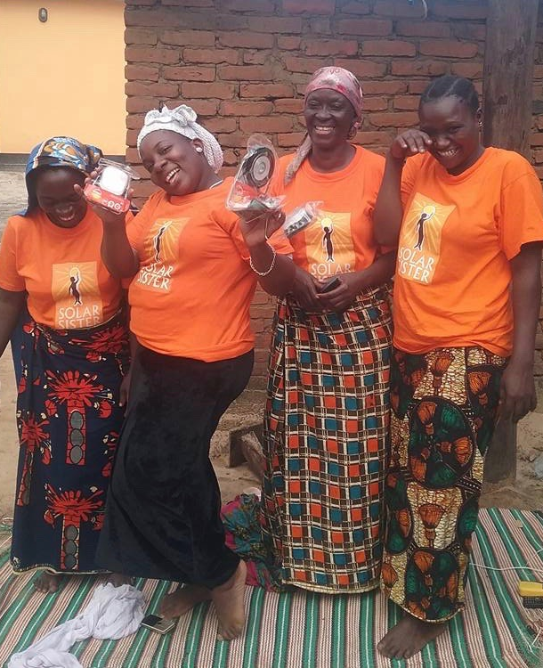
Women Powered
Solar Sister trains and supports women to deliver clean energy directly to homes in rural African communities.
We provide essential services and training that enable women entrepreneurs to build sustainable businesses in their own communities.
Business is designed to be sustainable from day one – a “business is a bag” that is highly adaptable to each woman’s individual life, available time, individual needs

Slide 28
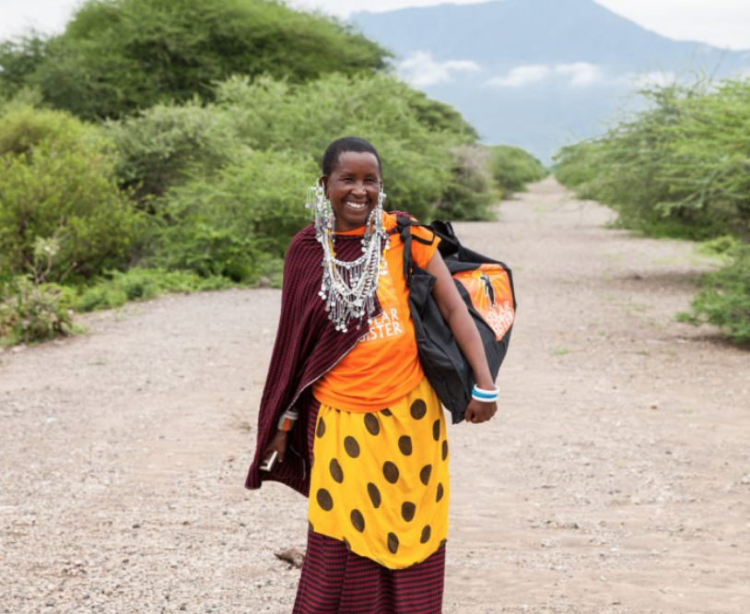
Business solution = Social impact
“Solar Sister training helped me increase my income – taught me about customer care, how to save and the importance of building trust.”
Hilaria, Solar Sister

Slide 29
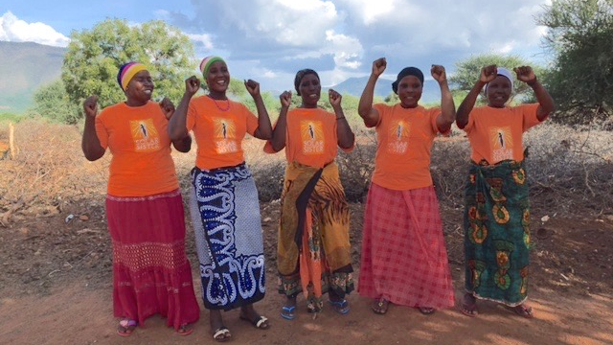
Yes We Can!

Slide 30
Any questions?

