Slide 1
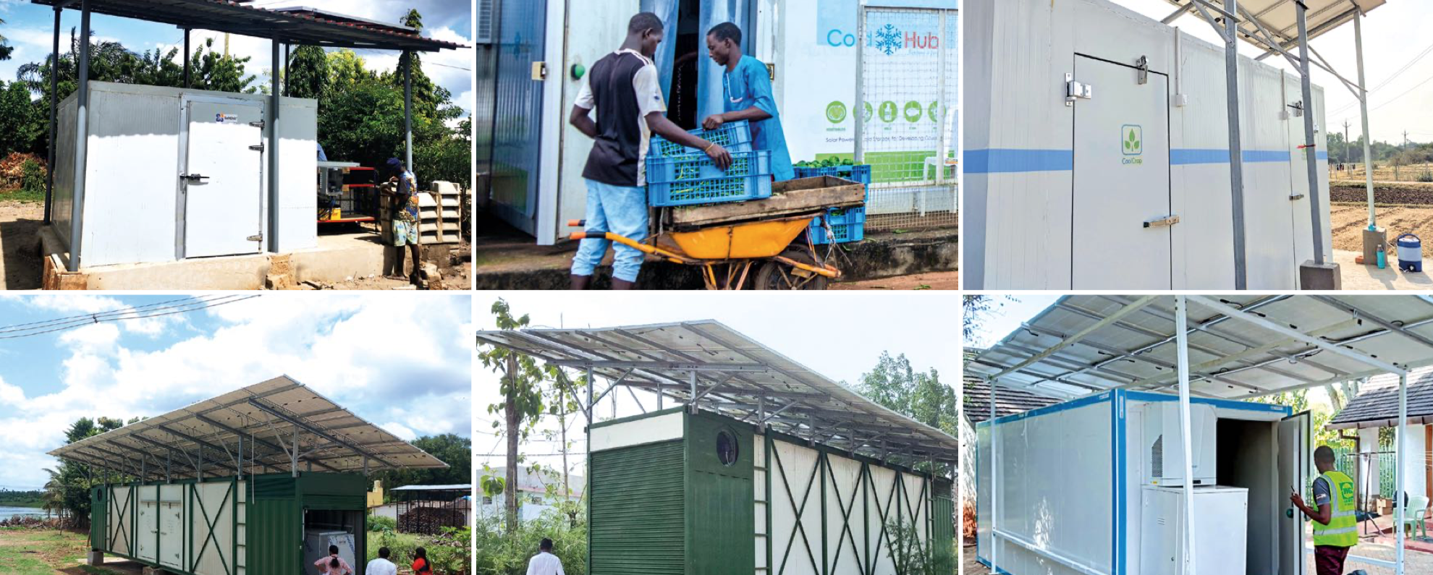
Walk in Cold Room Interest Group
8 September 2026
Off-grid, grid connected and hybrid

Slide 2
Agenda for Third Meeting, 8 September 2026
Introductions
PART I: Using the WICR test protocols and product information template
The VeraSol approach
WICR Product Information Sheet template
Field test methodology
Lab test methodology
PART II: Discussion
Q & A
Other initiatives on WICR
Next steps for test method:
  Solar PV
  Defrost
  Thermal energy storage

Slide 3
Introductions to our team and the VeraSol programme
Sonja Mettenleiter (Nairobi)
Jeremy Tait (Germany)
Sally Musonye (Nairobi)
Anna Wright (Washington, DC, USA)
Christopher Carlsen (Quebec, Canada – unable to attend today)
Notes:
Introduction 10m Lead:
Team introduction; note diversity of audience; attendees use chat to introduce themselves. Important temporary members of our team - Test Method Expert Group (list names on slide incl. MISA) big thanks to them
?Reminder: what VeraSol is (aims, components, benefits)
Reminder: objectives of the WICR initiative
Agenda for the session - Two Parts

Slide 4
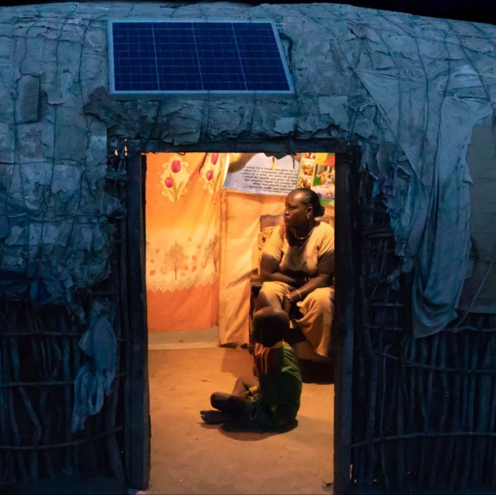

Leaving No One Behind
VeraSol works to increase access to modern energy services through high-quality off-grid solar products and systems that build confidence in modern solar solutions and protect the most vulnerable consumers.
180+ million
people have benefitted from using VeraSol quality-verified products.
www.verasol.org

Slide 5











VeraSol is a quality assurance program
for modern off-grid solar solutions
c
c
c
c
c
Solar Energy Kits
Electric Pressure Cookers
Refrigerators & Freezers
Walk-In Cold Rooms
Solar Milling
c
c
c
c
c
Large PV
Systems & Public Institutions
Solar Water Pumps
Egg Incubators
Solar Generators
Fans
www.verasol.org

Slide 6


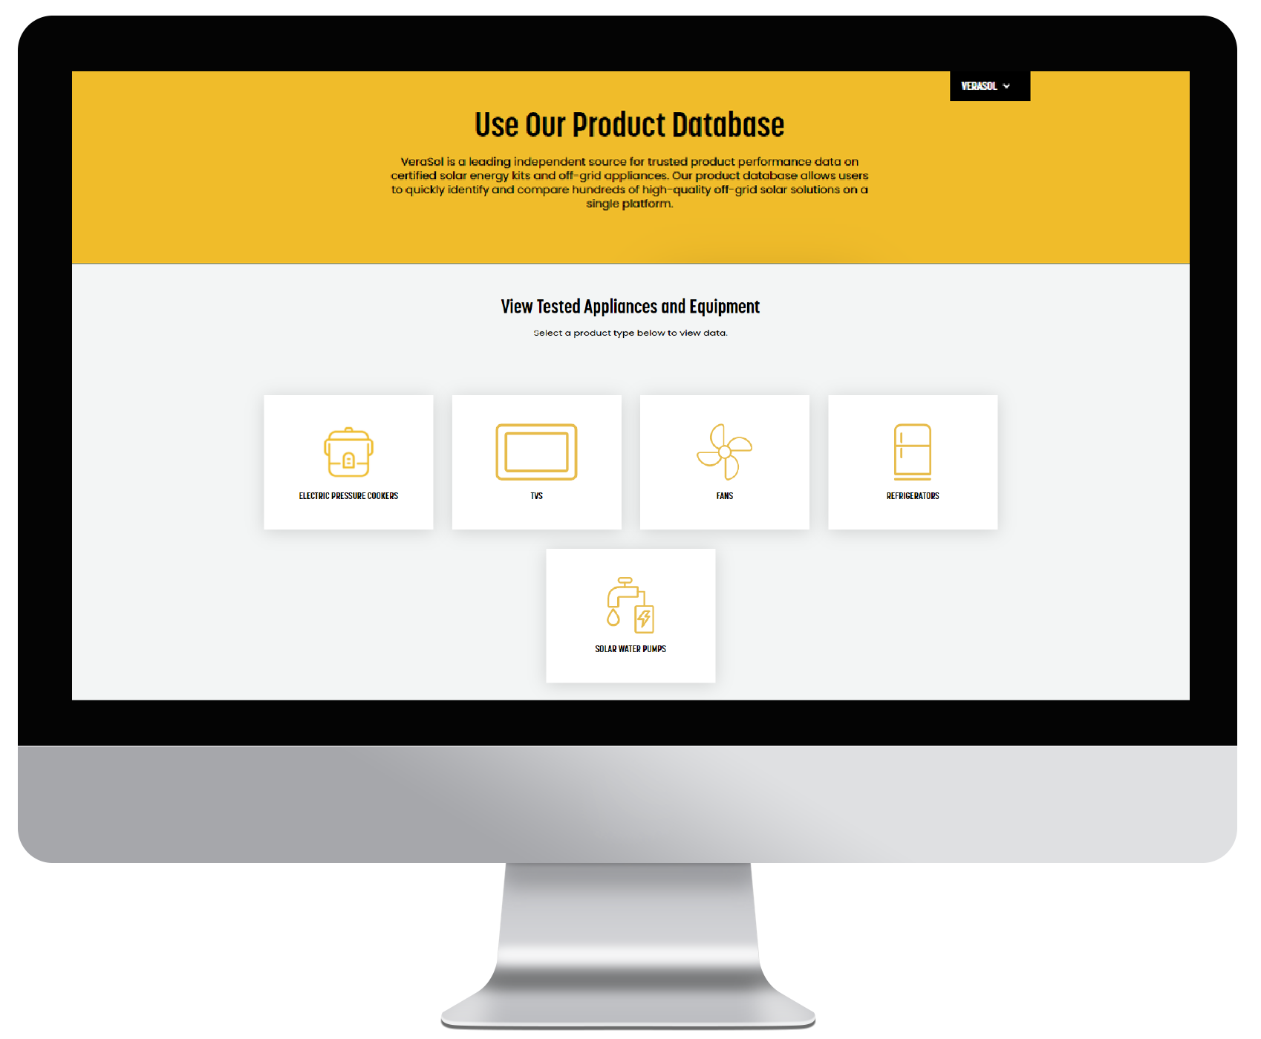
Elements of VeraSol Quality Assurance Framework
VeraSol Quality Assurance Framework
CERTIFICATION
Evaluate and confirm products meet quality standards
VeraSol is a quality assurance program that supports high-performing, durable off-grid solar solutions.
QUALITY STANDARDS
Determine and set baseline levels of product quality
TESTING & DATA
Generate product performance and quality data to inform actions
TEST LAB CAPACITY
Identify and support testing partners to provide testing services
TEST METHODS
data.VeraSol.org
Define how product quality and performance is measured

Slide 7
PART I: a) Overview of the VeraSol approach to WICR quality
Anna Wright

Slide 8
Why QA for WICR?
1. Ensure Performance & Reliability
  Protect perishable goods with consistent temperature control
  Reduce breakdowns and downtime
2. Safeguard Investments
  Cold rooms are high-value assets
  Quality assurance lowers lifecycle costs and ensures durability
3. Support End-User Confidence
  Farmers, distributors, and businesses can trust WICRs to deliver
  Builds market reputation for suppliers and installers
4. Enable Market Growth
  Standardized quality benchmarks foster fair competition
  Supports wider adoption of cold storage solutions in off-grid and weak-grid areas
www.verasol.org

Slide 9
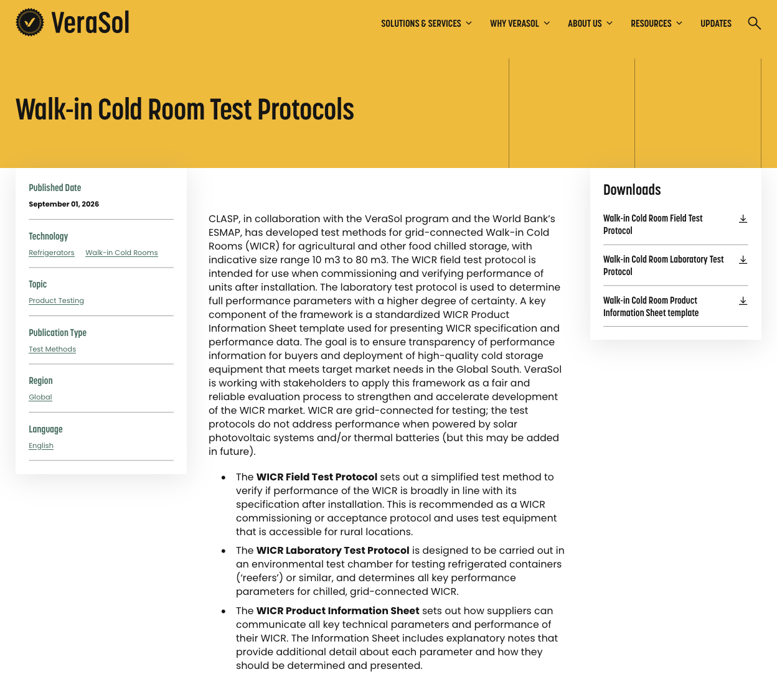
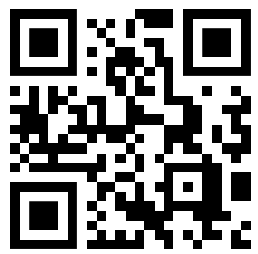
Documents now available on the VeraSol website
Published at
www.verasol.org
search “WICR” to find them.
Or use QR:
https://verasol.org/publications/walk-in-cold-room-test-protocols/
WICR Product Information Sheet template
Field Test protocol
Lab Test Protocol

Slide 10

Potential roles of VeraSol documents in WICR supply
Supplier's advertising
Product listing
Tender, purchase, market support
Install and commission
Operation
WICR Product Info Sheet
Lab test method
Field test method
Notes:
Chris: For the “tender/purchase” step, I suggest either mentioning that this could also be for market-support mechanisms like RBFs, or adjusting the text to include this use case.
In orange, we have steps to procuring a WICR and in green we have these newly-published WICR QA resources.

Slide 11
PART I: b) The WICR Product Information Sheet template
Jeremy Tait

Slide 12
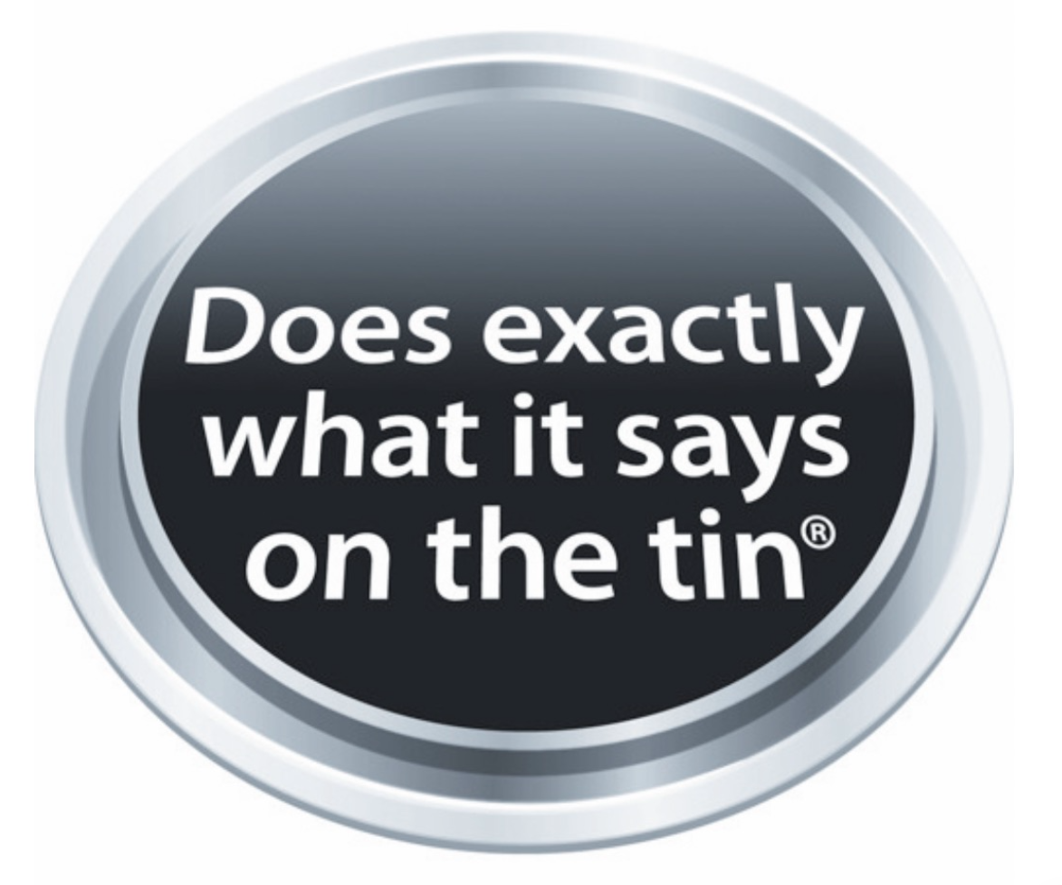
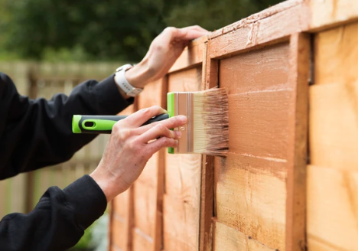
https://www.ronseal.com/the-ronseal-brand/the-ronseal-phrase/
Notes:
People use the phrase every day, it has come to represent a product or policy that is open and honest; it is used when something quite simply ‘Does Exactly What it Says on the Tin’.
After the initial campaign, sales shot up and Ronseal became [a] brand leader.
The phrase has come to represent a product or policy that is open, honest and delivers against its promise.

Slide 13
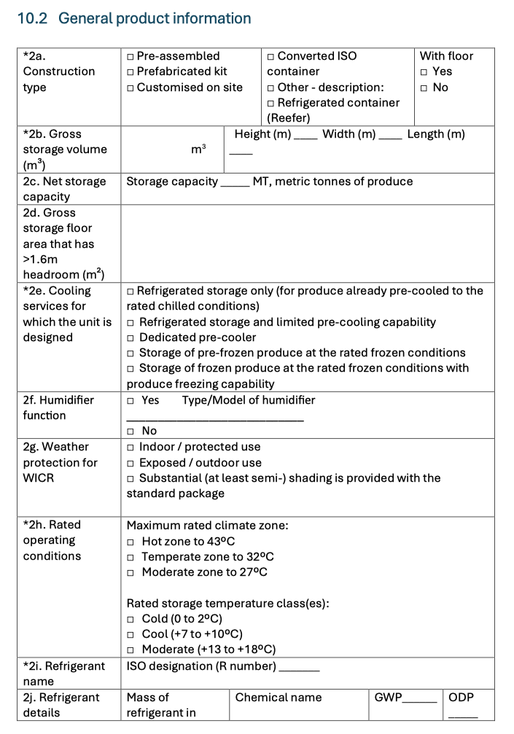
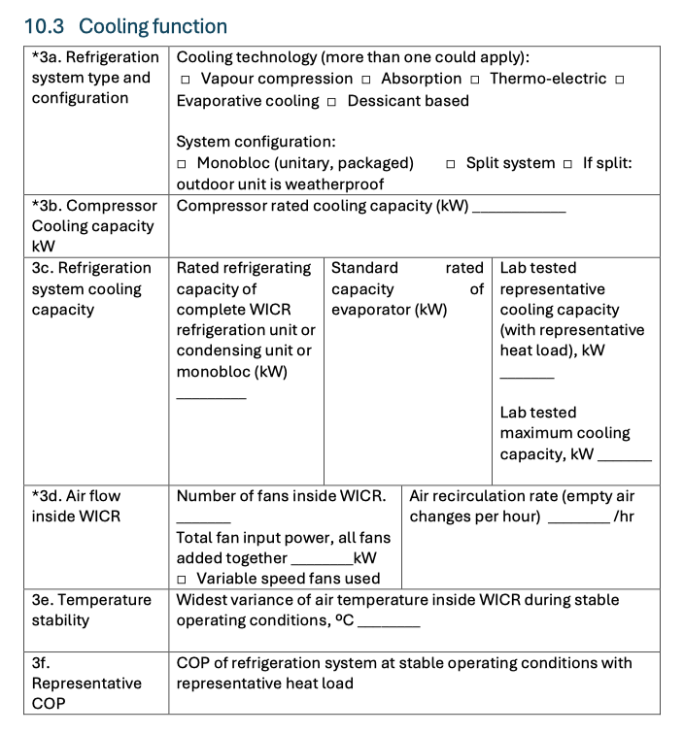
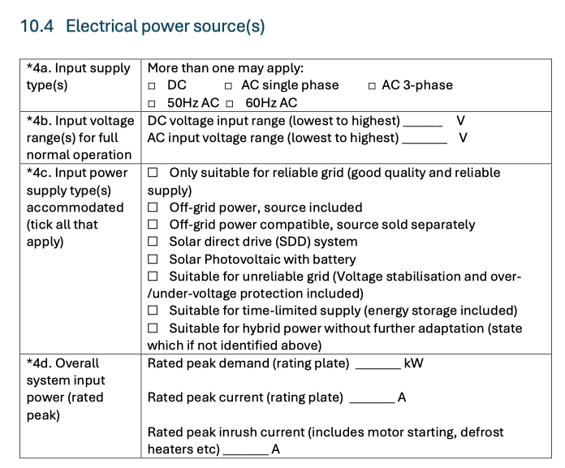
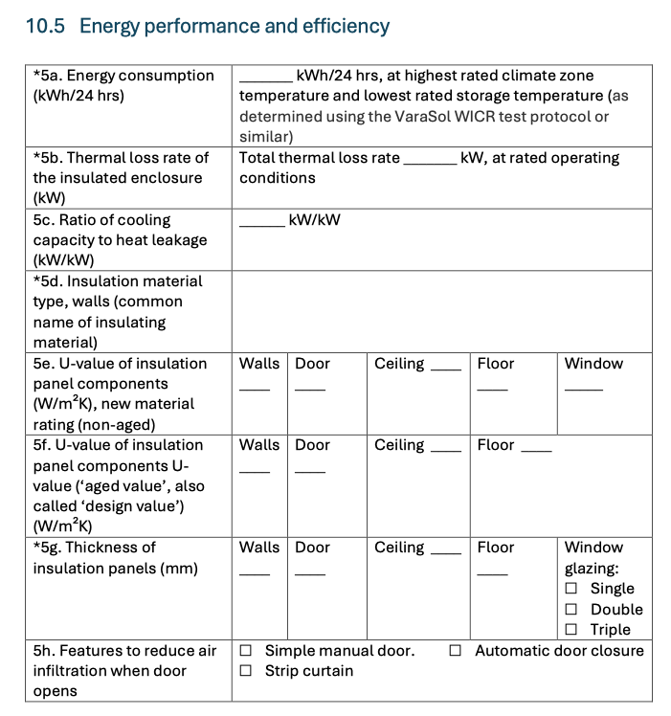
WICR Product Information Sheet:
A standard way to fully and fairly inform buyers
- Some parameters required for VeraSol product listing; others recommended
- Recommended parameters for suppliers to adopt into brochures and specs
- Recommended for procurement managers to adopt into their processes

Slide 14
The WICR Product Information Sheet: a template for accurately describing WICR
What it is:
What it achieves:
A WICR technical specification template (Excel sheet) for suppliers to adopt and adapt
Common language and metrics to explain features and functionality
Suppliers can explain what they offer and differentiate their products
Buyers can articulate what they need and find the most suitable WICR for their needs
Focus on aspects important to customers and to preserving quality of produce
Fair assessment of tenders; fair competition to improve products and performance
Lists the technical parameters most likely to be of interest to buyers, programmes and market support mechanisms
Explains common metrics and units of measure that are easiest to understand and verify
Part of VeraSol product listing process
Use the parameters in your brochure and spec sheets

Slide 15
Content of the WICR Product Information Sheet template
List of information and useful parameters with guidance on what to write and how to determine values
Seven information sections:
Supplier information
Product information
General technical specification
Cooling function
Electrical power sources
Energy performance and efficiency
Compliance and certification
Drop-down lists of options for some parameters; mostly free text but follow the guidance
Explanations and supporting notes invited as well as documents as evidence

Slide 16
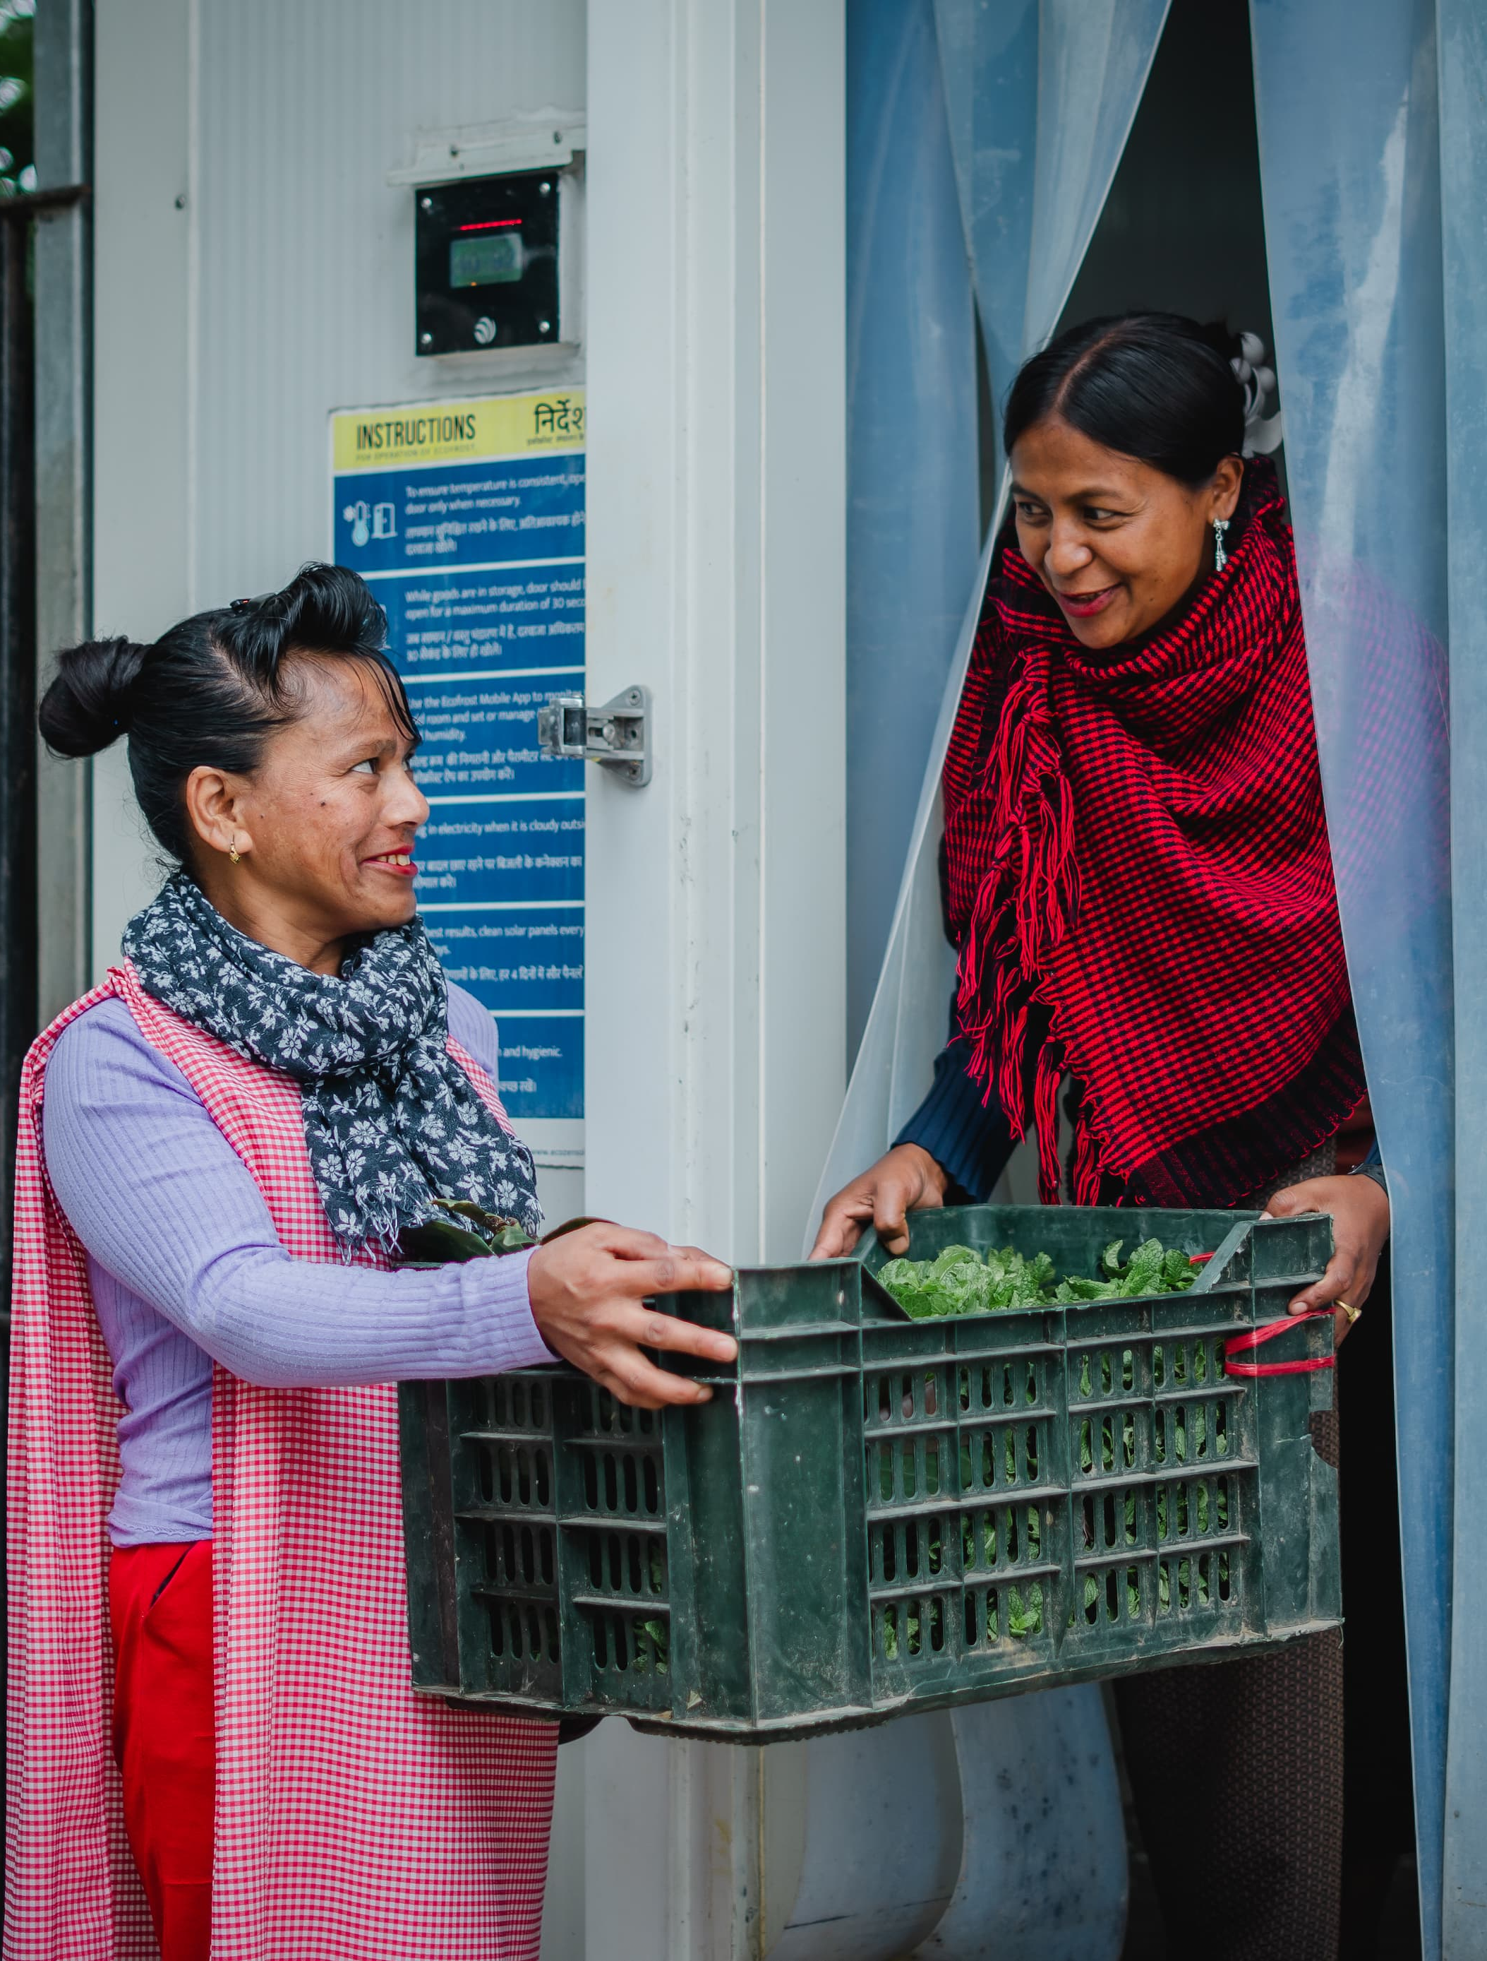
Using the WICR Product Information Sheet in Practice
Anna Wright

Slide 17
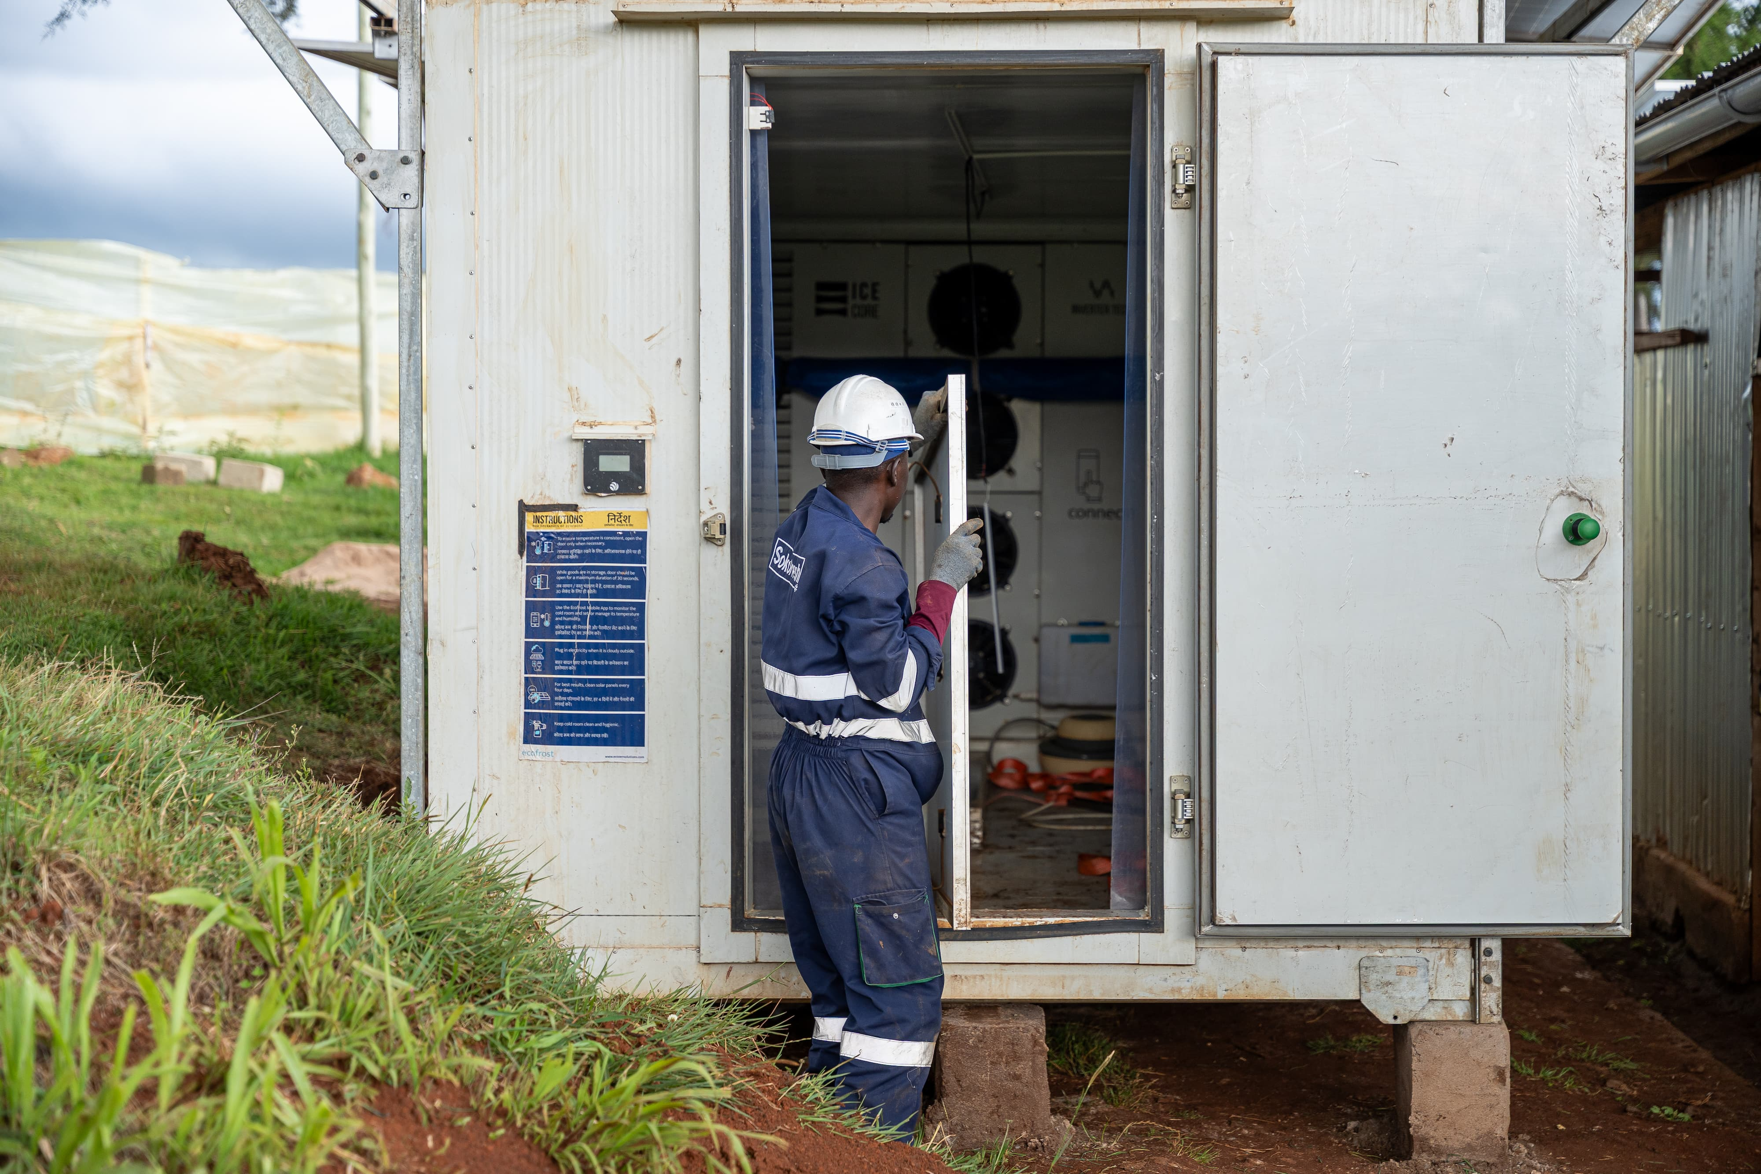
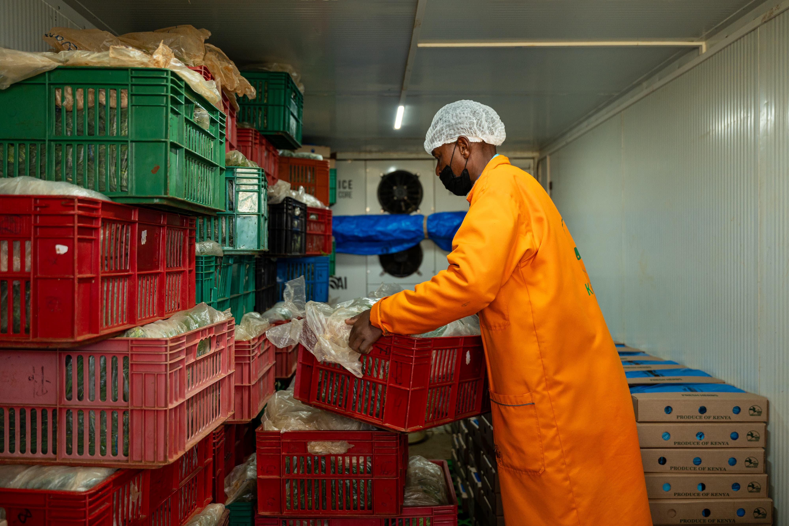
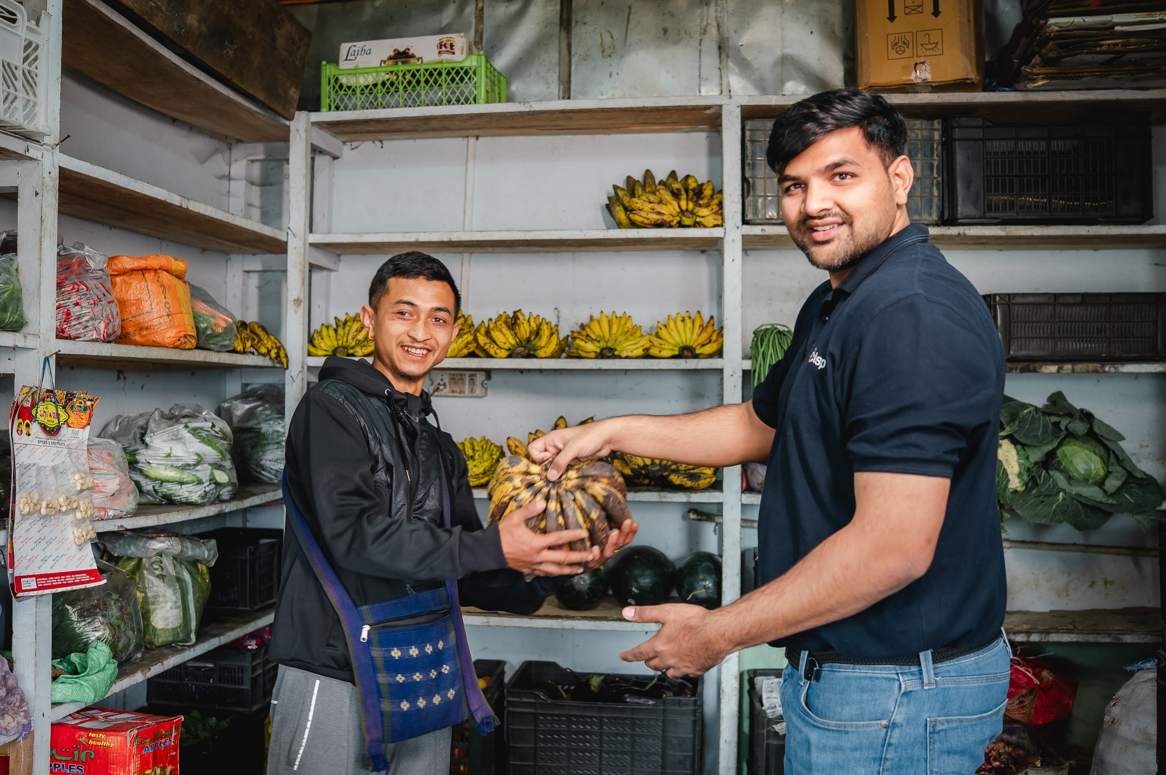
Harmonized product information helps build markets
Common Information
Easier Comparison
Better Decisions
Stronger Markets

Slide 18
One form, multiple uses
Who? | How can they use standardized product information?
Suppliers | Communicate product specifications and performance consistently Demonstrate conformity with requirements
Buyers / procurers | Define requirements Compare products Inform procurement and selection
Program implementers | Establish eligibility criteria Screen products
Testing & verification partners | Identify products and specifications Inform testing Compare declared and measured performance
WICR operators / users | Understand product capabilities Make informed purchasing and operating decisions
Financiers / investors | Technical due diligence and assessment of products being financed
Notes:
Segue idea for passing over to Siena for PUFF:
A common information framework connects actors across the WICR market - from product offering and procurement to testing, financing and deployment.
One of these applications is using standardized product information to establish and verify product eligibility in an RBF program.

Slide 19

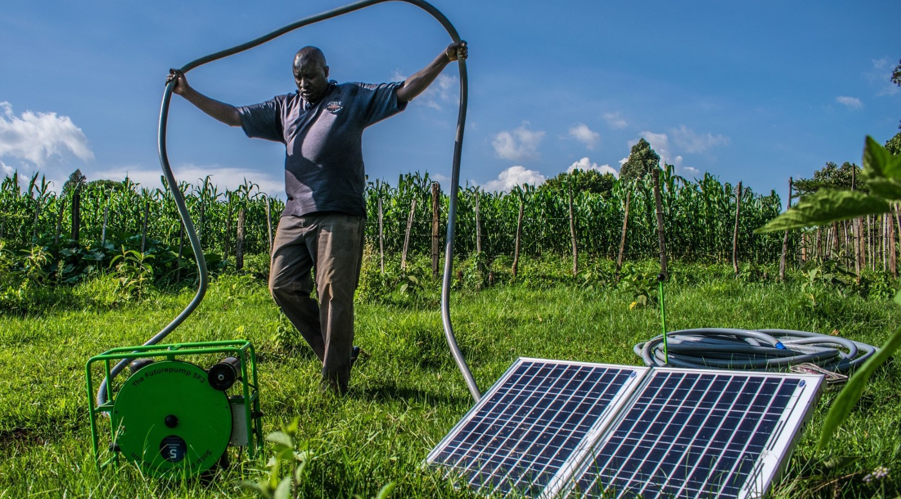
Using the WICR Product Information Sheet and field test methods for Productive Use Financing Facility (PUFF) eligibility
Siena Hacker
Productive Use Financing Facility
Quality assurance that works in practice
Notes:
PUFF is one practical example of a results-based financing program using the emerging WICR QA framework. I’ll focus on how we translate the framework into an eligibility decision—not repeat the technical presentations you have just heard.
[Sources]
- PUFF 2.0 EWAS onboarding materials
- VeraSol WICR Interest Group Meeting flyer (29 Jul 2026).

Slide 20
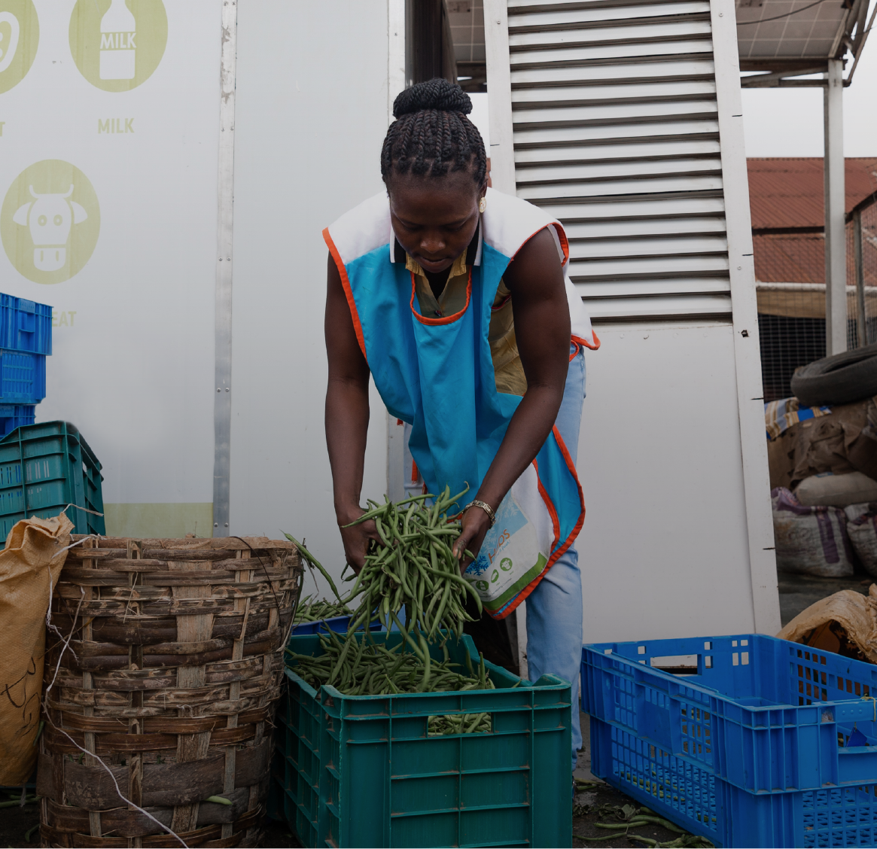
PUFF expands access—with quality guardrails
RESULTS-BASED FINANCING
Lower prices. Reach more customers. Protect end users.
▪
Procurement subsidies, enterprise development grants and technical assistance
▪
Operating in Nigeria, Kenya and Ethiopia through 2028
▪
WICRs are high-cost systems: weak performance can undermine both customer livelihoods and donor value
2
Notes:
PUFF is managed by CLASP and supported by the Global Energy Alliance for People and Planet. The essential point for today is that QA is not separate from the financing mechanism: it is one of the guardrails that determines which products public and donor funding can responsibly support.
[Sources]
- PUFF 2.0 EWAS onboarding deck
- PUFF Final Narrative Report
- CLASP/PUFF Expanded Track Eligibility Guidance (23 Jun 2026).

Slide 21
For WICRs, eligibility is an evidence-to-decision process
1
2
3
4
5
Identify model
& configuration
Complete core package
+ WICR info sheet
Review evidence
& resolve gaps
Set eligibility
& conditions
Verify installation
& field performance
Three possible evidence pathways
Accredited third-party testing • Recognized prior evaluation • Administrator-directed targeted assessment
The same minimum applies across pathways: identity, credible functional performance, basic safety, warranty, and usable installation / operation / maintenance documentation.
3
Notes:
For WICRs, PUFF currently uses the Expanded Track. Every submission needs a core evidence package and the additional WICR information sheet. The pathway changes the evidence basis, but not the need to know exactly what model is being supported or to establish a minimum quality threshold. Approval can carry additional monitoring or post-installation verification conditions.
[Sources]
- PUFF Expanded Track Eligibility Guidance (23 Jun 2026)
- VeraSol WICR Quality Framework snapshot (24 Nov 2025)
- EWAS PUFF Terms & Conditions (Mar 2026).

Slide 22
The Product Information Sheet makes claims assessable
It turns a complex system into a consistent record of what is being sold, how it should perform, and what evidence supports each claim.
1
Product identity
5
Durability
model, configuration, construction
insulation, enclosure, components, maintenance
2
Cooling performance
6
Consumer protection
rated climate, temperature, capacity
warranty, price, service and spare parts
3
Energy system
7
Environmental safeguards
consumption, PV, batteries, autonomy
refrigerant, blowing agent, end-of-life
4
Safety
risk controls, electrical and refrigerant safety
Design rule learned in practice
Ask for units, rated conditions and supporting uploads beside the claim—not in a separate document hunt.
4
Notes:
The form is useful because a WICR is not one component; it is an enclosure, refrigeration system, power system, controls, installation and service model. Organizing the submission around the QA assessment areas makes the final review more consistent. We also learned the questions must specify units and rated conditions, explain why the information is needed, and place document uploads next to the claim.
[Sources]
- VeraSol-PUFF WICR Product Information Sheet Template (31 Aug 2026)
- Comments for PUFF Airtable (24 Jul 2026)
- VeraSol WICR Quality Framework snapshot (24 Nov 2025).

Slide 23
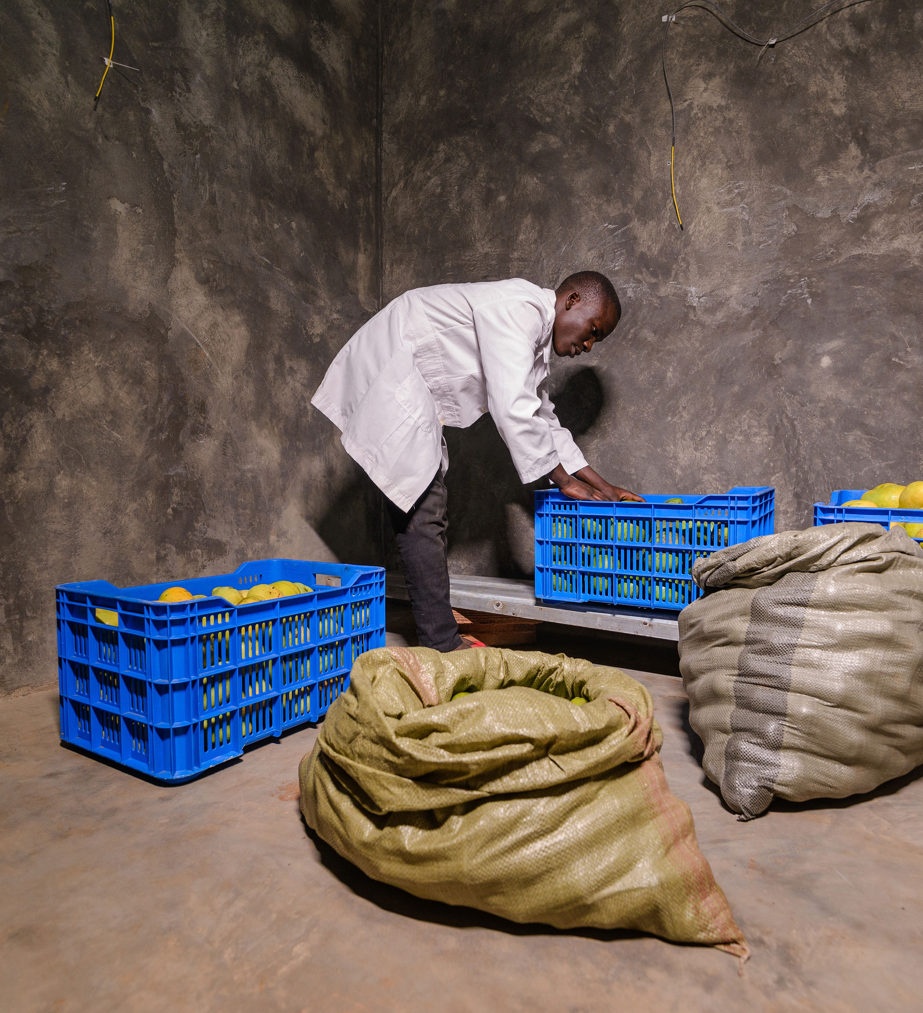
Real submissions exposed gaps between claims and evidence
Model traceability
Do photos, datasheets, certificates and the proposed unit describe the same product?
Internal consistency
Do dimensions, capacity, power and component claims agree across documents?
Rated conditions
At what ambient temperature and operating state were claims determined?
Evidence relevance
Does a certificate substantiate the claim—or only a component, standard or calculation?
These gaps led to clarification rounds—and strengthened the form and guidance.
5
Notes:
In the Ecotutu and Manamuz reviews, the challenge was rarely a completely empty form. It was determining whether the claims were credible and applicable to the exact model. Examples included conflicting dimensions or product descriptions, images not clearly tied to the model, claims without rating conditions, and certificates that did not demonstrate the performance claimed. This is why PUFF needs both structured data and technical judgment.
[Sources]
- WICR assessments for PUFF (Jul 2026)
- Ecotutu and Manamuz Airtable submissions and clarification records (Jul–Aug 2026).

Slide 24
Field tests connect declared performance to installed reality
DOCUMENT REVIEW
FIELD PERFORMANCE
What should be true
What happens on site
▪
Declared temperature range and rated climate
→
▪
Commission correctly and identify setup issues
▪
Cooling and energy performance claims
▪
Measure temperature, cooling and energy use
▪
System configuration, controls and safeguards
▪
Verify performance under actual operating conditions
For PUFF, the field method can support commissioning, conditional approvals and post-installation performance verification.
6
Notes:
The information sheet and field protocol solve different problems. The sheet creates a declared, traceable product record. Field testing then checks whether the installed system actually reaches the expected temperature and performance, and can help diagnose commissioning or configuration problems. PUFF can use that method proportionately: especially for higher-risk or conditionally approved systems and as part of downstream verification.
[Sources]
- VeraSol WICR Interest Group Meeting flyer (29 Jul 2026)
- VeraSol WICR Quality Framework snapshot (24 Nov 2025)
- PUFF 2.0 Verification & Disbursement Pathway.

Slide 25
A promising approach depends on disciplined implementation
WHAT IS WORKING
WHAT WE ARE STILL IMPROVING
✓
A common structure for complex WICR submissions
!
Suppliers may need support to provide rated, model-specific evidence
✓
Earlier visibility into technical and consumer-protection risks
!
Forms can become burdensome if every field is treated as a pass/fail gate
✓
A defensible basis for clarification and conditional approval
!
Technical judgment and review ownership must be consistent
✓
A product record that can inform procurement and later verification
!
Product or component changes require active change control
Our goal: enough evidence to protect customers and grant funds—without making QA a barrier to promising products entering the market.
7
Notes:
The main success is that the framework gives PUFF a practical way to assess complex products even when full laboratory testing is not yet available. The central challenge is proportionality. We want a clear yes/no eligibility decision and firm red lines on safety and minimum performance, but we do not want every desirable data point to become a barrier. The next maturity step is clearer supplier guidance, consistent decision rules and a strong approved-product/change-control record.
[Sources]
- PUFF WICR assessment ReadMe and July 2026 assessments
- PUFF Expanded Track Eligibility Guidance (23 Jun 2026)
- EWAS PUFF Terms & Conditions (Mar 2026).

Slide 26
PART I: c) The new WICR field test protocol
Sonja Mettenleiter

Slide 27
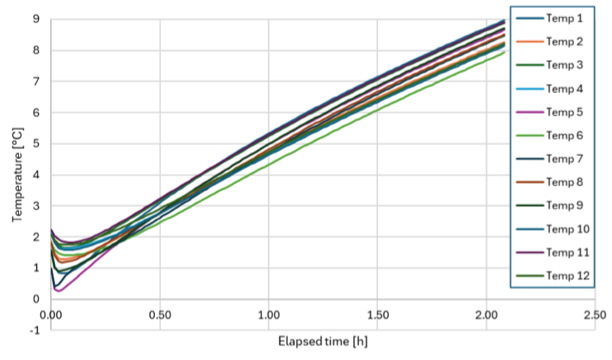
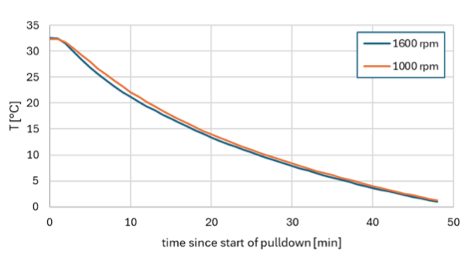
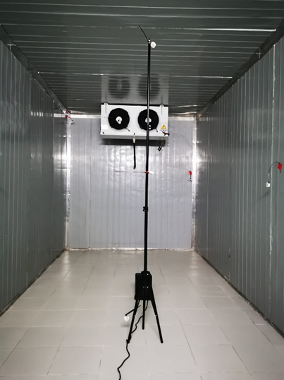
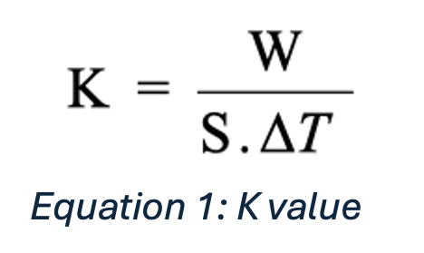
Overview of the VeraSol WICR field test protocol
Based on the ATP protocol for testing refrigerated containers, and a WICR test method from India
G
f
Autonomy test: switch off the cooling and measure time taken for average temp. to rise by 5ºC
Empty pull-down test from ambient temperature to the target storage temperature according to the cold room category
U
U
u
Heat leakage test (k-value): steady state with fan heater inside, adjusted to a target temperature difference inside/outside -> calculate
k-value
0
Steady state effectiveness test with fan heaters inside: temp. stability, energy consumption, cooling capacity, COP
Notes:
K = overall heat transfer coefficient of the insulated enclosure (k-value), in W/m².ºC.
W = heat leakage rate (equivalent to the heating power or cooling capacity required to maintain the constant absolute temperature difference ∆T), in Watts.
S. = geometric mean surface area, in m²
∆T = the temperature difference between the mean inside temperature and the mean outside temperature, ºC.

Slide 28
Overview of the field tests and equipment
Test | Contents of WICR storage volume | WICR internal air (storage) temperature at start | Representative heat load
Visual inspection of insulated enclosure and key components in the field | Empty | n/a | n/a
Empty Pull-Down Field Test | Empty | Equal to climate zone temperature/ ambient temperature | None
Autonomy test | Empty | At target storage temperature | None
Steady state effectiveness for air temperature, representative energy consumption, representative cooling capacity and maximum cooling capacity | Empty, with heaters and fans as needed | At target storage temperature | Yes, as per 4.5 in the test method document
Determination of heat leakage rate and k-value of the insulated enclosure | Empty | See Table 8 in the test method document | None
Test equipment:
Min. 5 temperature sensors
Min. 1 humidity sensor
Data logger
Electrical power meter
Support rig(s) to hold sensors at suitable heights and locations
Handheld temperature sensor
Multi-meter (for checks and troubleshooting during set up)
Adhesive tape
Flash light
Stopwatch
Camera to record test set up
Tape measure
Adequately powered heater
Extension cable

Slide 29
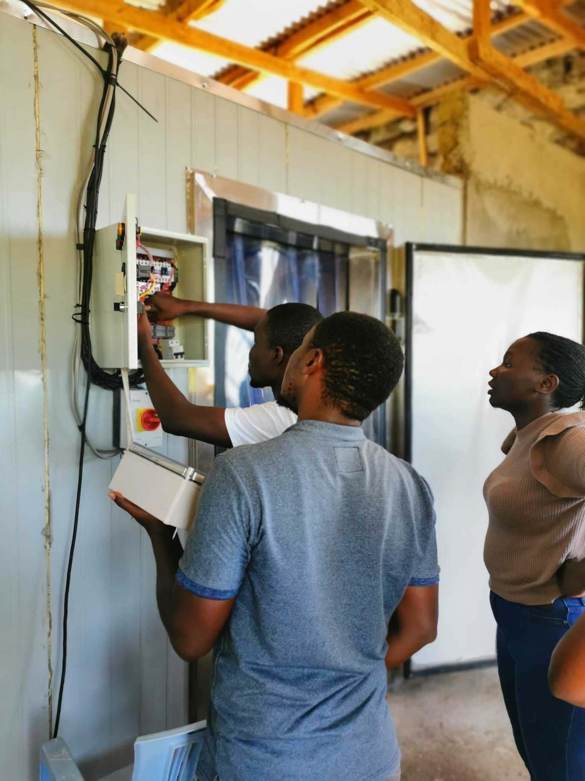
The field test in practice:
Insights from
Carren Atieno (Kijani Testing Ltd.)
&
Dennis Onkangi (Kuza Freezer)

Slide 30
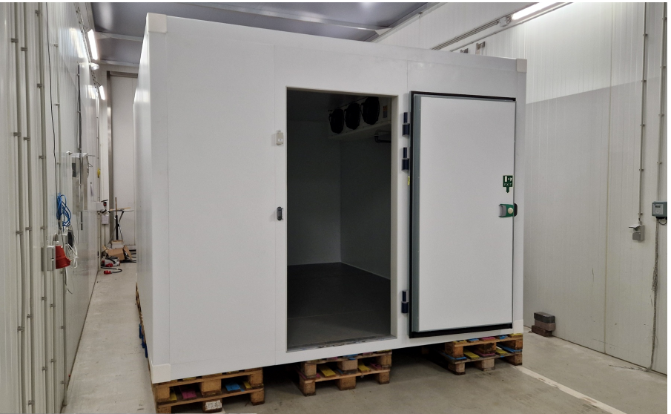
Field-Testing the VeraSol WICR Protocol
What stands out-Kijani Perspective
Simple, locally available tools
No specialized or imported equipment: temperature/humidity sensors, an electric fan heater, an energy meter, a camera, and a Fluke infrared sensor for pre-test distribution checks.
Clear, plain-language protocol
Steps are written in accessible language, so a field team can follow them without needing a lab-technician background.
Extensive photo documentation
Thorough enough to support the report, but demanding it takes two people to manage cables, staging, and shots at once.
Standardized report outline
A consistent structure for reporting data and findings, so results from different testers and sites can be compared directly.
Meaningful parameters, like the k-value
Outputs go beyond pass/fail, giving testers real insight into the unit's actual insulation performance taking in account the various climatic conditions reflecting the ideal environmental conditions.
Easy to spot faults and errors
The multiple sensor arrangement surfaces anomalies quickly a mis-placed sensor still cost us a repeat test in Mbita.
21

Slide 31
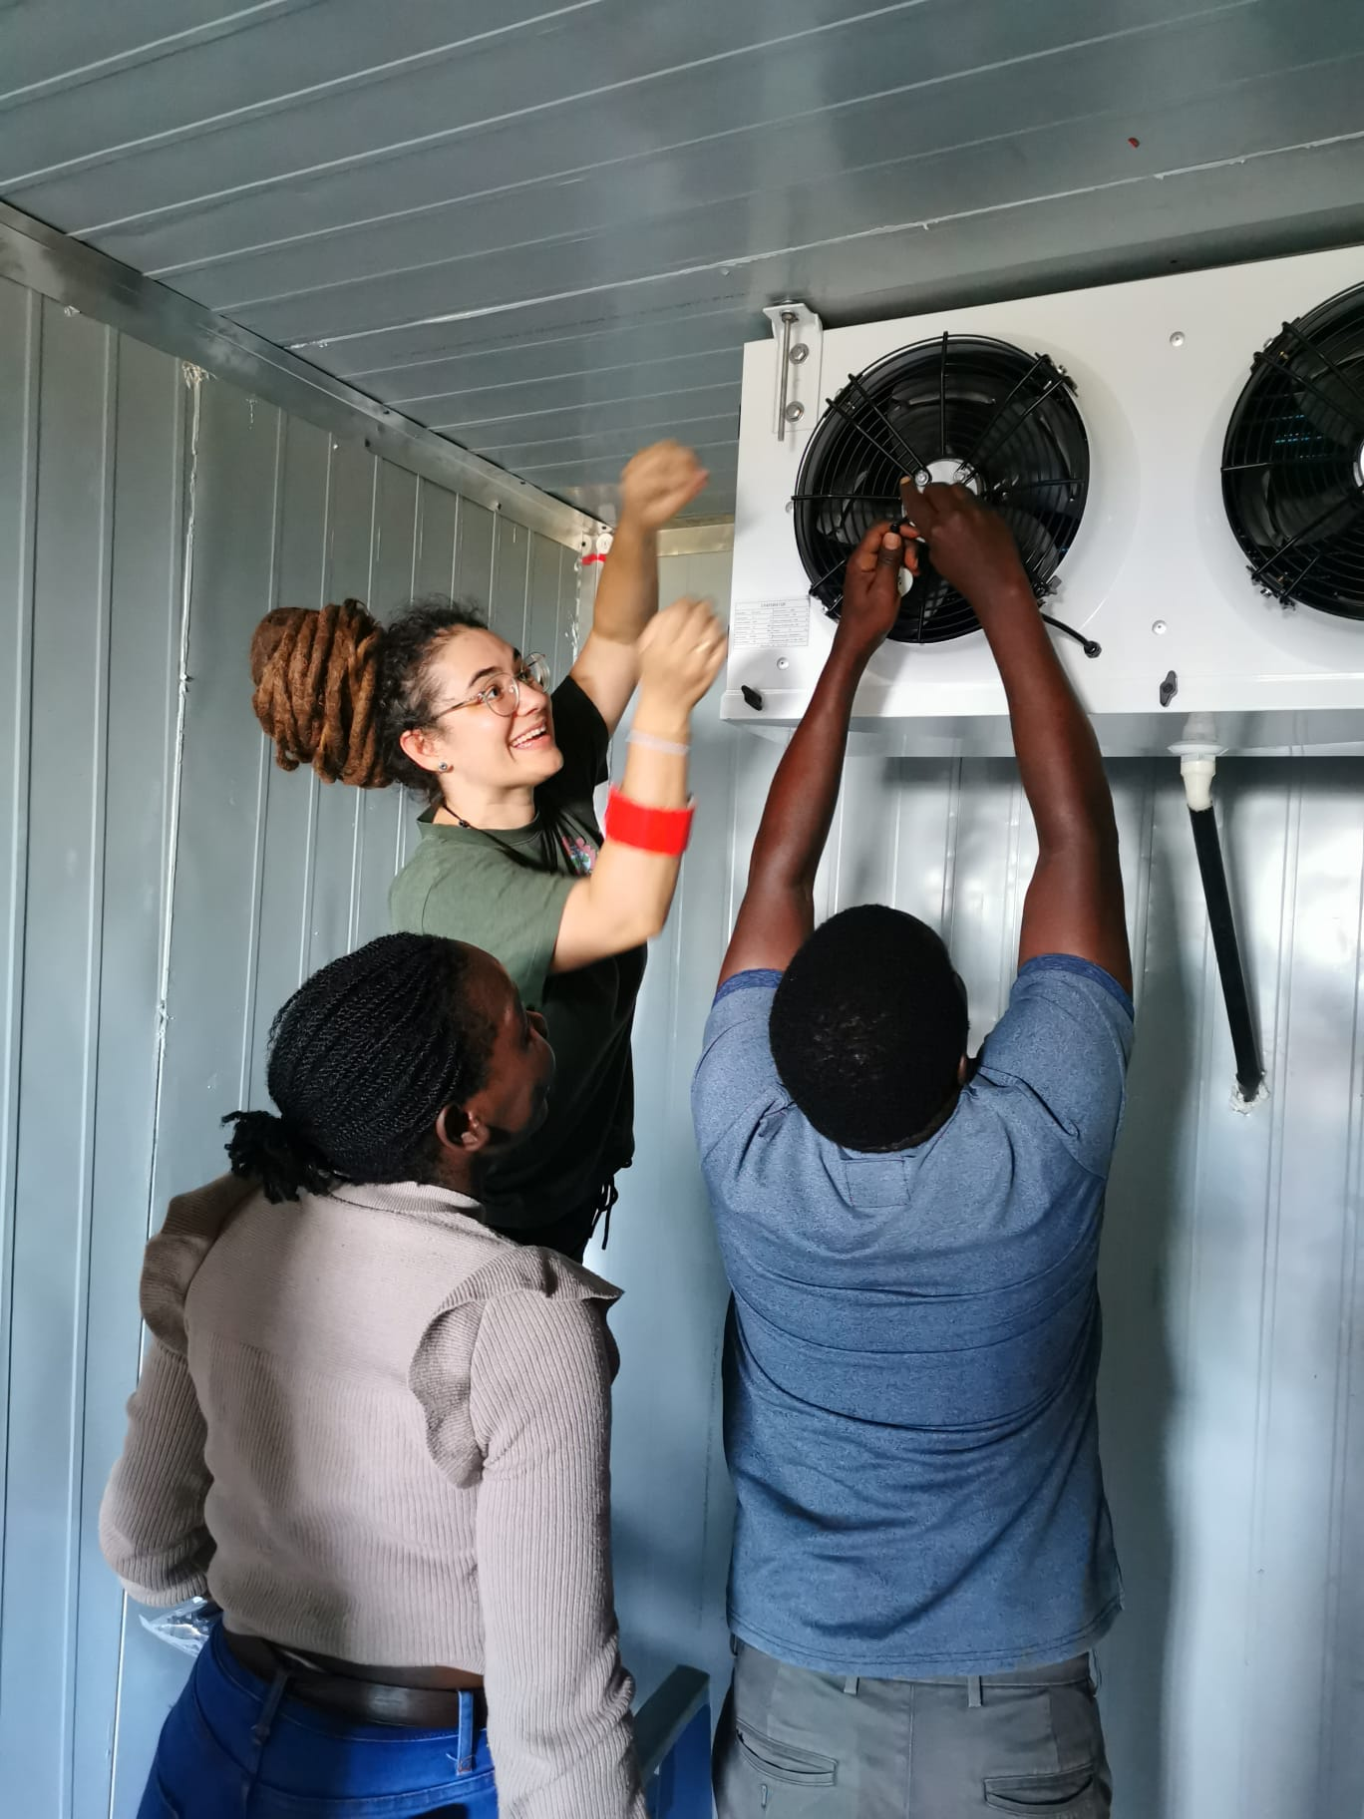
What This Means for Kijani
Testing a recognized protocol builds capacity, credibility, and repeatability
More WICR tests & validation requests
1
A field-proven capability positions Kijani for more work as adoption grows from commissioning checks to spot audits of registered units.
Standardized steps mean results can be trusted and compared directly across sites, testers, and time.
2
A repeatable, comparable test method
Bringing together the suppliers and manufacturer and technical experts during the tests.
3
Brings suppliers, manufacturers & experts together
Tip
Keep spare sensors on hand for replacement — placements do fail.
Secure a stable power supply before you start testing.
Great to run before commissioning the systems — but also because it requires the cold room to be completely empty, so plan around storage downtime.
Placing a sensor at the evaporator, as a team
21

Slide 32
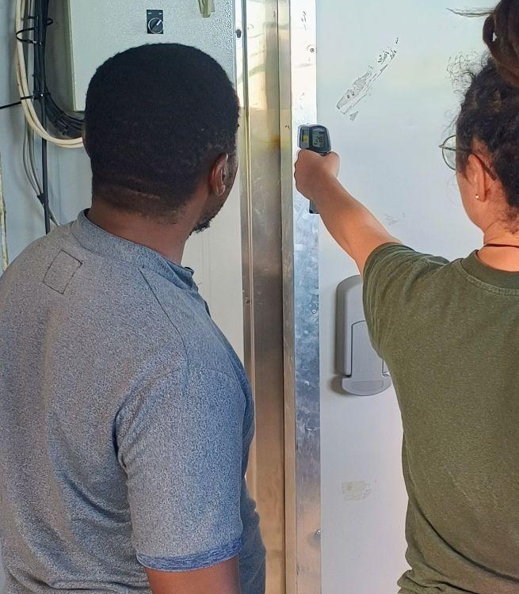


Testing Before Launch: From Installation to Performance
Why testing the Homabay Hub changed how we think about cold-chain infrastructure.
DENNIS ONKANGI
Founder & CEO
Solar-powered cold storage facility - www.kuzafreezer.com

Slide 33



TESTING
COLD ROOM INSTALLED
MEASURED PERFORMANCE
BEFORE OPERATIONS
PERFORMANCE
FOCUSED
WHAT CHANGED
Not yet operational
How efficiently?
Identify weaknesses
No fish inside
How consistently?
Improve operations
Low operational risk
Under what conditions?
Manage risk

Slide 34
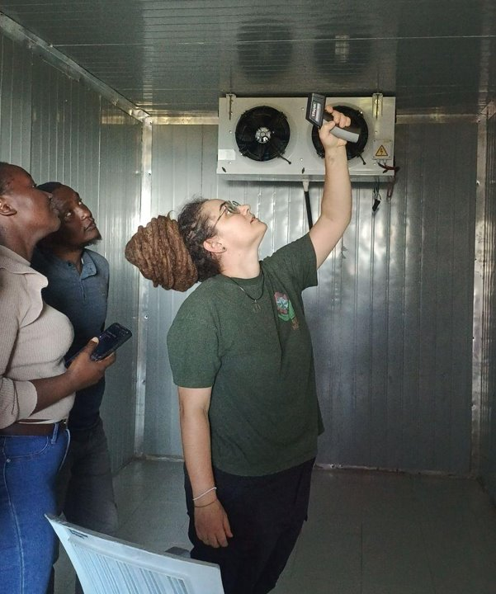




We looked beyond “Is it cold?”
Temperature • Energy • Pull-down • Cooling capacity • Autonomy
We measured, not assumed
Multiple sensors revealed what we couldn't see by simply standing inside the room.
We found opportunities to improve
Door insulation was identified as an area requiring improvement.

Slide 35
PART I: d) The WICR lab test protocol
Jeremy Tait

Slide 36
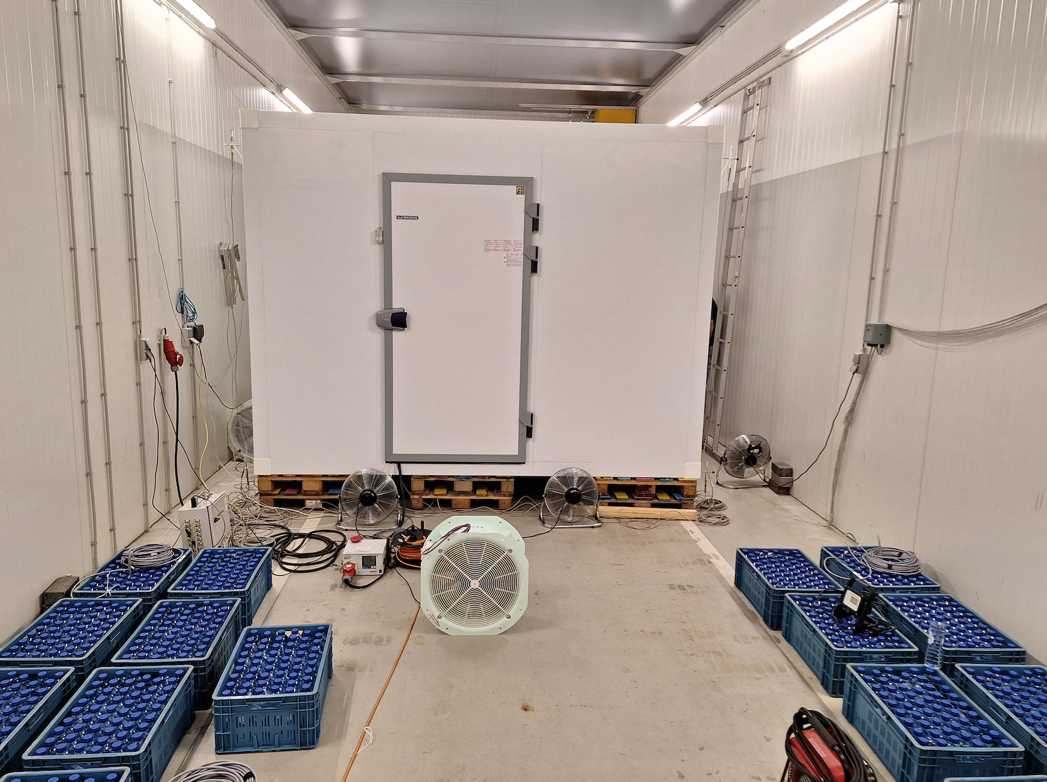
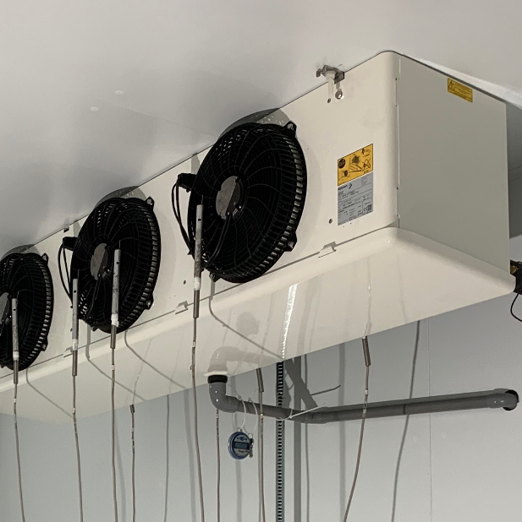
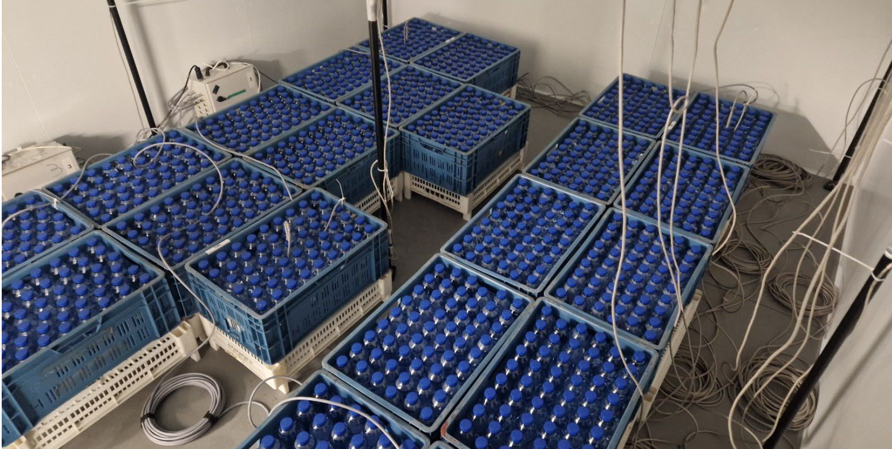
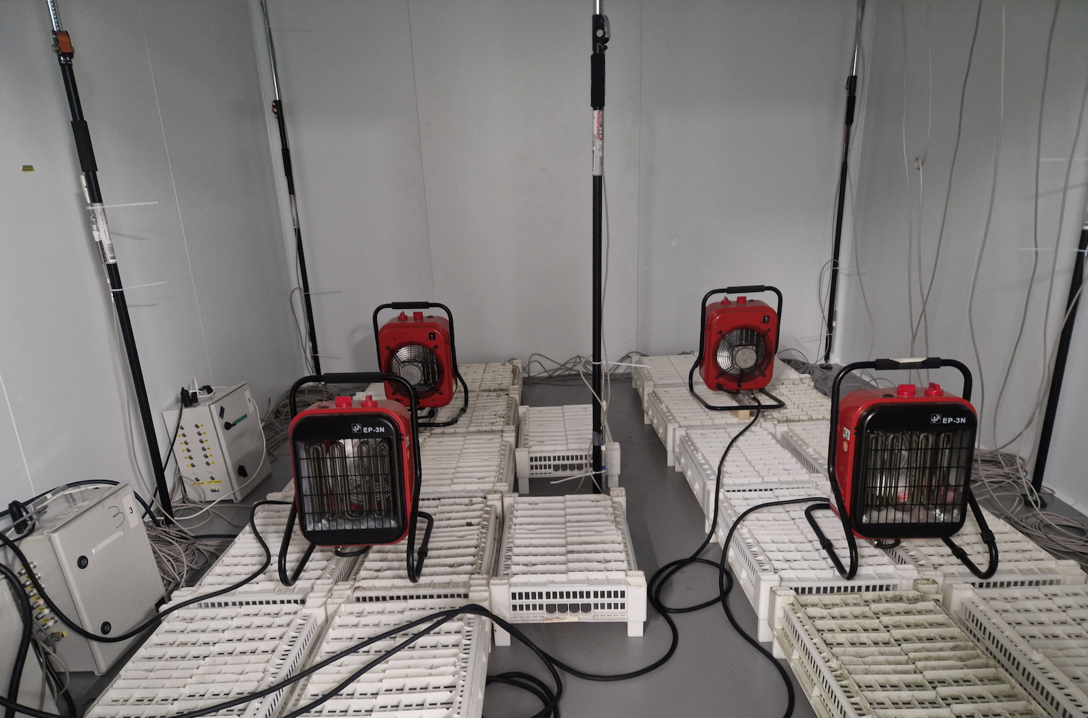
WICR lab test protocol:
In a thermal chamber (e.g., ATP chamber for refrigerated containers) for a stable and controlled test environment
Comprehensive instrumentation for authoritative results (repeatable, reproducible)
Same tests as field test protocol, plus: pull-down test with dummy load (crates of water bottles), fan air flow test, maximum cooling capacity
Justified for larger scale procurement and certification processes.
Notes:
Not expected to be a standard part of VeraSol registration

Slide 37
PART II: Questions, clarifications, discussion
Jeremy Tait

Slide 38
Questions and Discussion
Please use the Q&A chat function
Or ‘raise your hand’ using the Teams icon
Or you can email us to respond after the webinar:
  Jeremy Tait (jeremy@taitconsulting.de)
  Sonja Mettenleiter (sonja@mettenleiter-consulting.com)
Documents at www.verasol.org, search “WICR”.
  WICR Product Information Sheet template
  Field Test protocol
  Lab Test Protocol
https://verasol.org/publications/walk-in-cold-room-test-protocols/

Slide 39
Further development of test specs
We invite volunteer experts to join small working groups on:
  Assessment of solar PV systems supplied with the WICR (suitability, field test protocol)
  Specification and performance of thermal energy storage
  Performance of defrost system
We anticipate two technical discussion meetings for each group online, during September to November, plus commenting on draft documents.
Please respond to the webinar follow up email if you would like to volunteer for a working group.

Slide 40
Next steps
Suppliers: prepare how you will complete the WICR Product Information Sheet; get field test evidence about performance of your WICR
Buyers, procurement managers: start building these parameters into your procurement specifications and processes; consider the field test protocol for acceptance and commissioning purposes
Technical experts: help us further develop the criteria – get in touch.

Slide 41
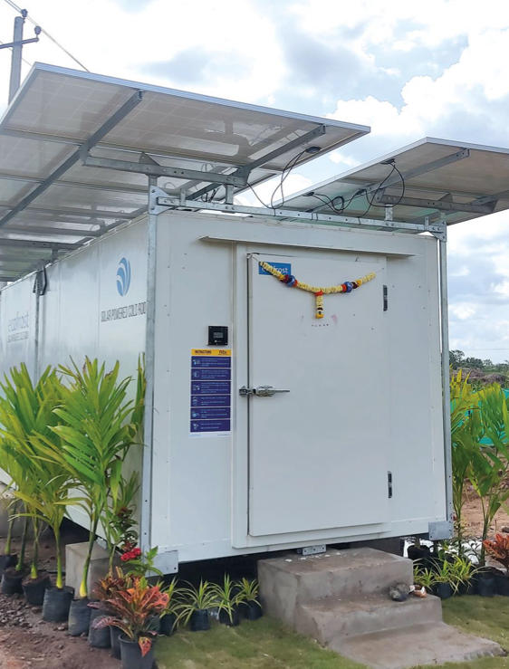
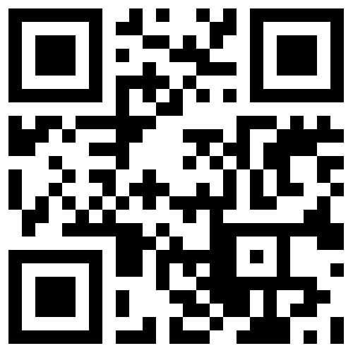
Thank You!
Keep Up with VeraSol:
VeraSol.org
LinkedIn
Subscribe to our newsletter
Reach out directly:
Christopher Carlsen (ccarlsen.consultant@clasp.ngo)
Sally Musonye (smusonye@clasp.ngo)
Anna Wright (awright@clasp.ngo)
Jeremy Tait (jeremy@taitconsulting.de)
Sonja Mettenleiter (sonja@mettenleiter-consulting.com)

Slide 42
WICR Interest Group #3, 8 September 2026
Stakeholder interest group on quality of Walk in Cold Rooms (WICR). Third meeting.

