Slide 1







The 2026 Global LEAP Awards for Repairability
Informational Webinar Session
8th April 2026

Slide 2
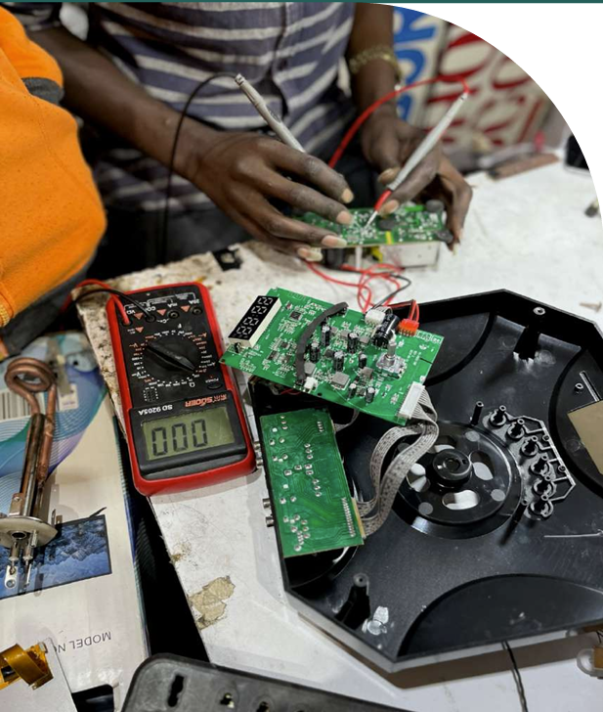
Content
Awards Overview
Award Administration Process
Who Can Participate
Why Participate
Key Award Elements
Application Process
Evaluation Process
Timelines
Q&A
5

Slide 3
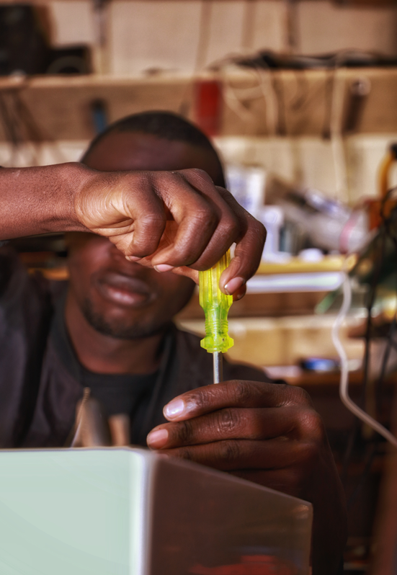
Global LEAP Awards for Repairability
Objective: to identify, support, and promote solutions that strengthen repair models and systems for PUE appliance companies and repair service providers operating in off- and weak grid contexts
PUE in scope : solar water pumps, refrigerators, and fans
Geographic scope : Kenya, Uganda, Ethiopia, and India.
6

Slide 4
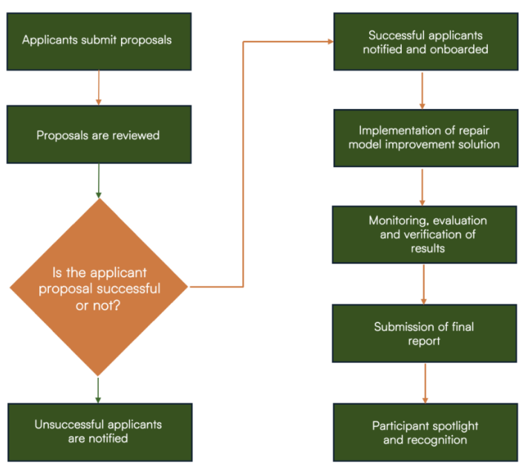
Awards Administration Process

Slide 5
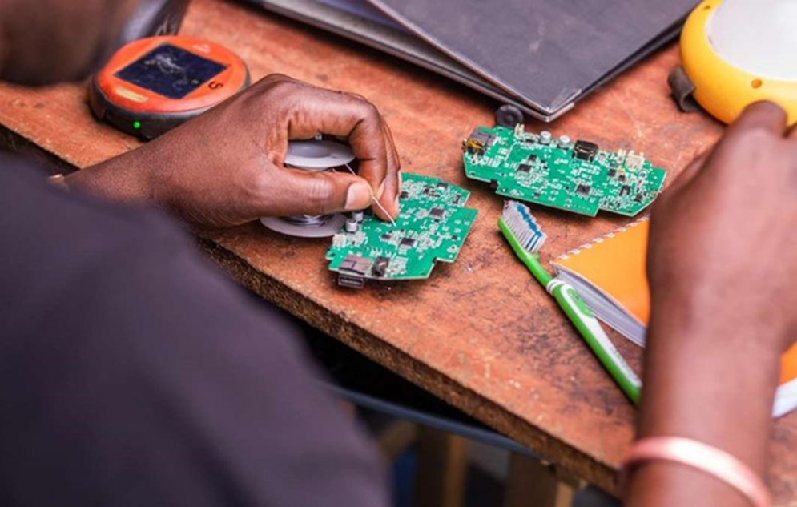
Who Can Participate?
Productive use appliance companies (“PUE Companies”). This can include any type of company that manufactures and distributes productive use appliances specifically solar water pumps, refrigerators, and fans.
Other specialized service providers (“Service Companies”) with operations that are directly relevant to providing repair solutions for productive use appliances. This includes, for example, recyclers, repairers, refurbished appliance resellers etc.
Joint proposals by two or more Participants are welcome. In all such instances, a single participant must serve as the lead applicant.
6

Slide 6
Why Participate?
Opportunity implement an innovative, readily actionable, high impact solutions towards improving your repair models
Cash Awards of up to $15,000 per successful participant to implement proposed repair model improvement solutions
Visibility and promotion through spotlight profiles and sector platforms such as the Off-Grid Solar Repair Lab, highlighting successful approaches and lessons learned to inform broader market ecosystem.

Slide 7
Key Awards Element
Implementation of the repair model improvement solution
3-month timeframe
Align with principles of a good repair model
Monitoring, Evaluation & Verification (MEV) of Results
Monthly tracking against milestones and indicators
Monthly progress check-ins + lessons learned
Physical site visits
6

Slide 8
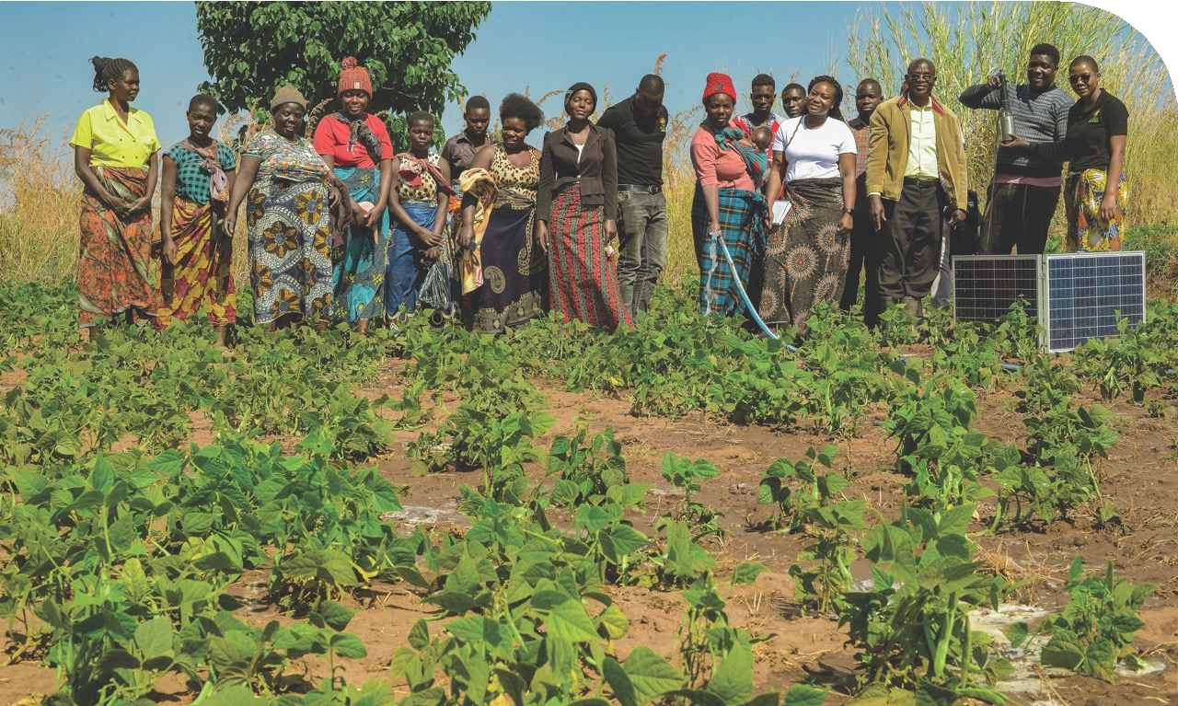
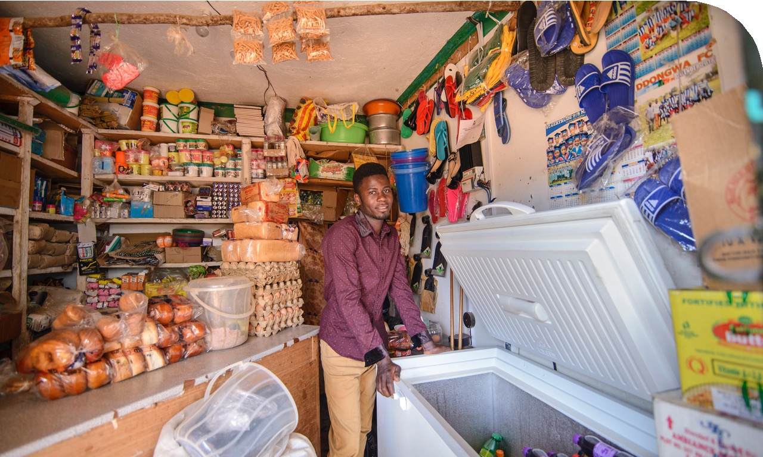
Application Process
Application Window Timeline:
Opens 1 April 2026 – closes 17th April 2026
Application process
Read the Terms and Condition Document
Proceed to Apply on online application
Contact Information
Who should I Contact with Questions?
globalleap@efficiencyforaccess.org
Is there a fee to participate?
Online submission of Application Forms is free.
7

Slide 9
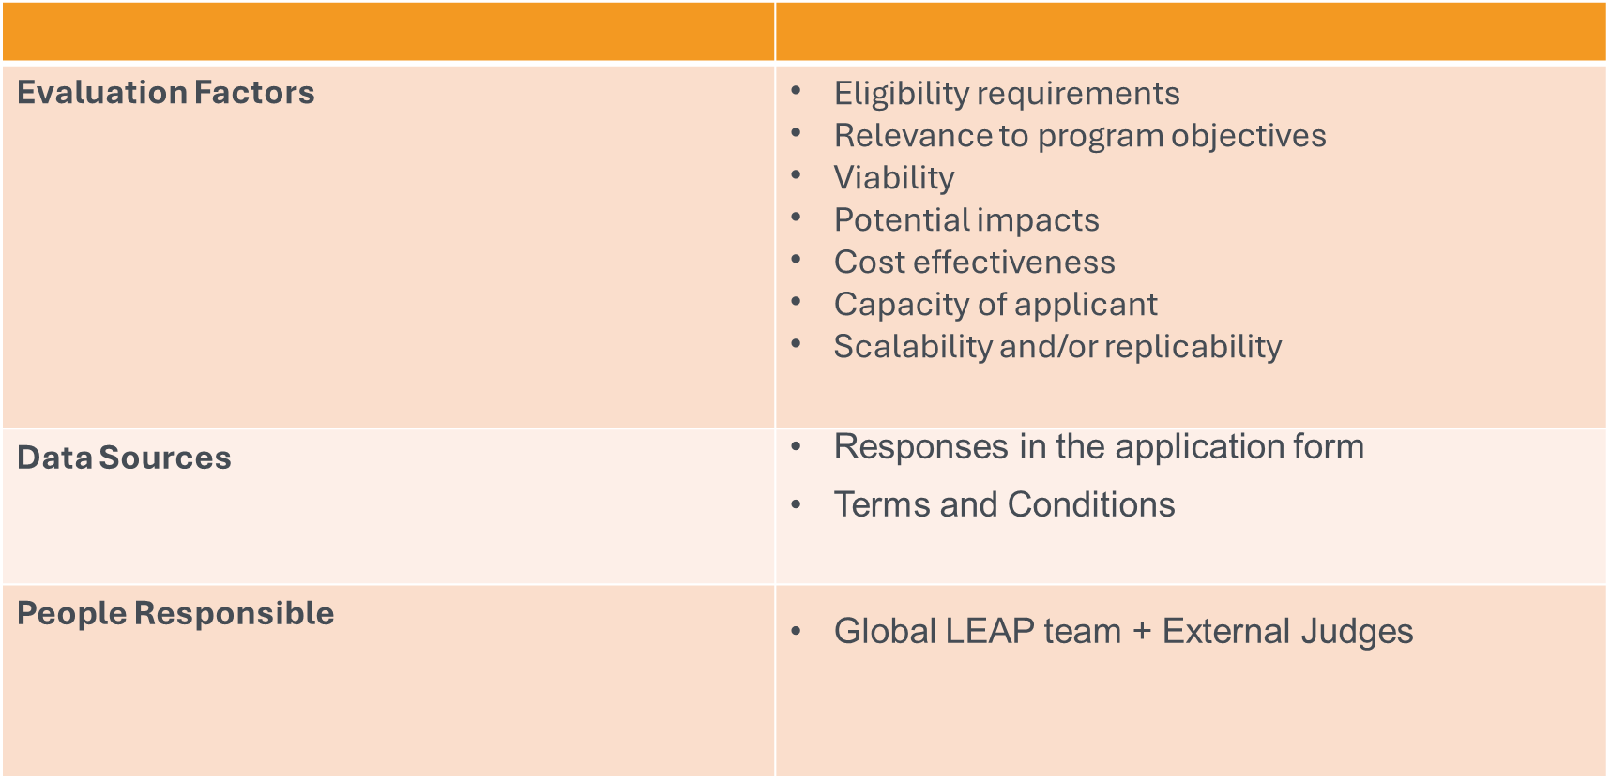
Evaluation Process

Slide 10
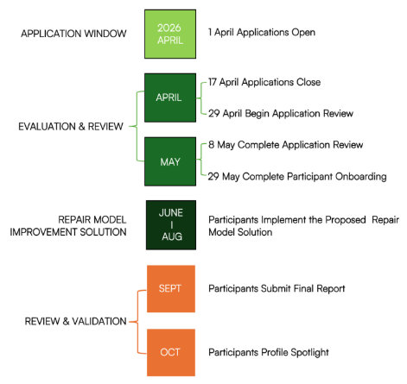
Timeline

Slide 11

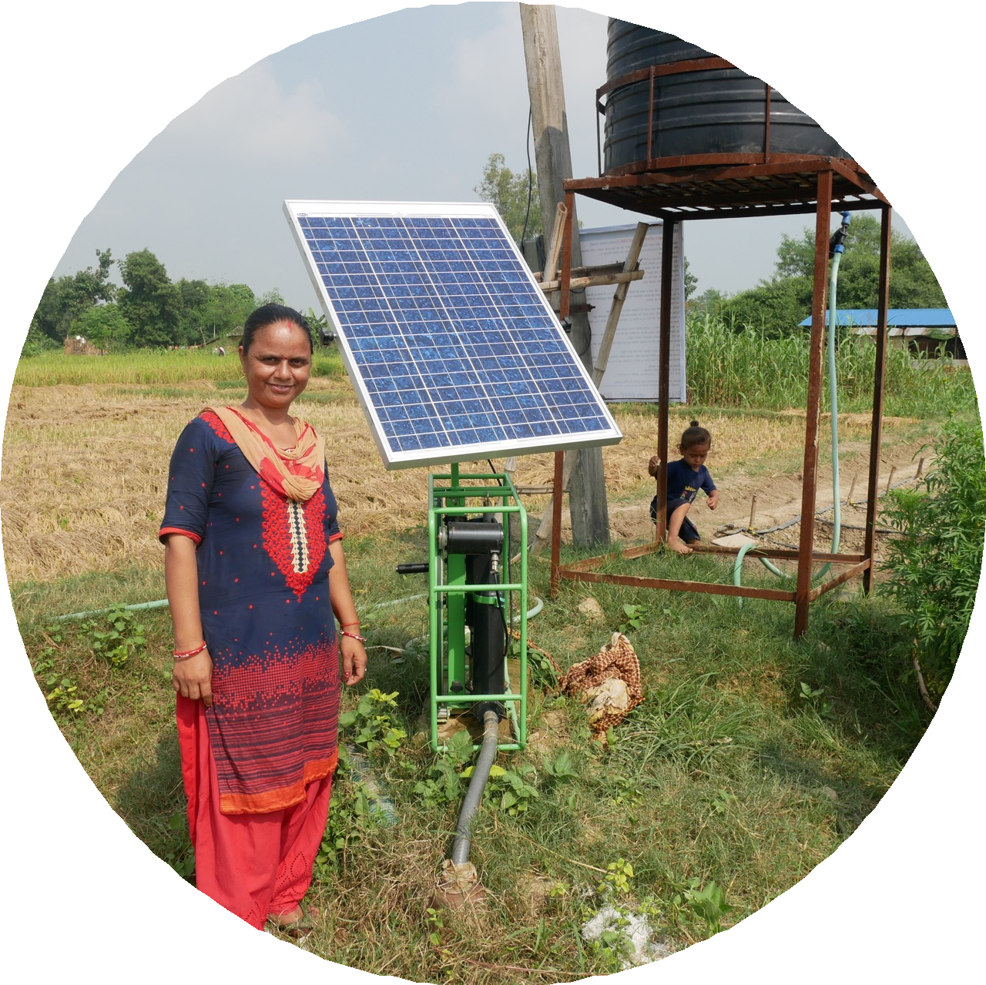
Thank you
Any Questions?

