Slide 1





2025 Global LEAP Awards Competition for Induction Cooktops
December 2025

Slide 2

Agenda
Competition overview
Main competition components
Who and why participate?
Competition process
Eligibility criteria (General and Technical)
Required documentation
Nomination process
Evaluation process
Timelines
Q&A

Slide 3
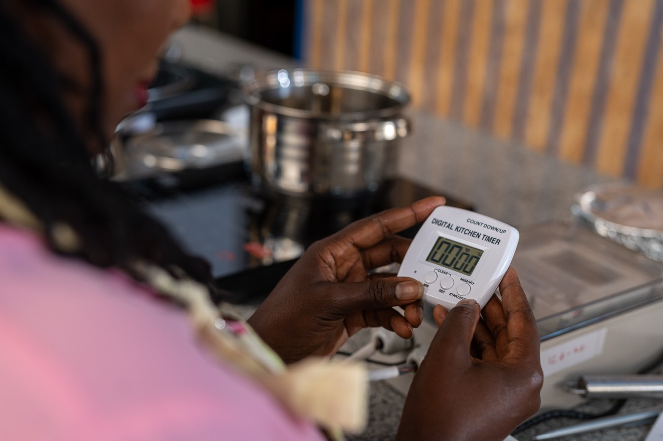
The 2025 Global LEAP Awards Competition for Induction Cooktops
The Global LEAP Awards is an international Competition that identifies and promotes world’s best , most energy – efficient appliances and equipment intended for use in energy constrained settings.
The 2025 Global LEAP Awards is the 2nd round of the Induction Cooktops Competition building on the success of the inaugural 2024 Competition which tested products in Kenya and India.
It aims to identify the best Induction cooktops currently available, based on safety, performance, ease of use and value for money.

Slide 4
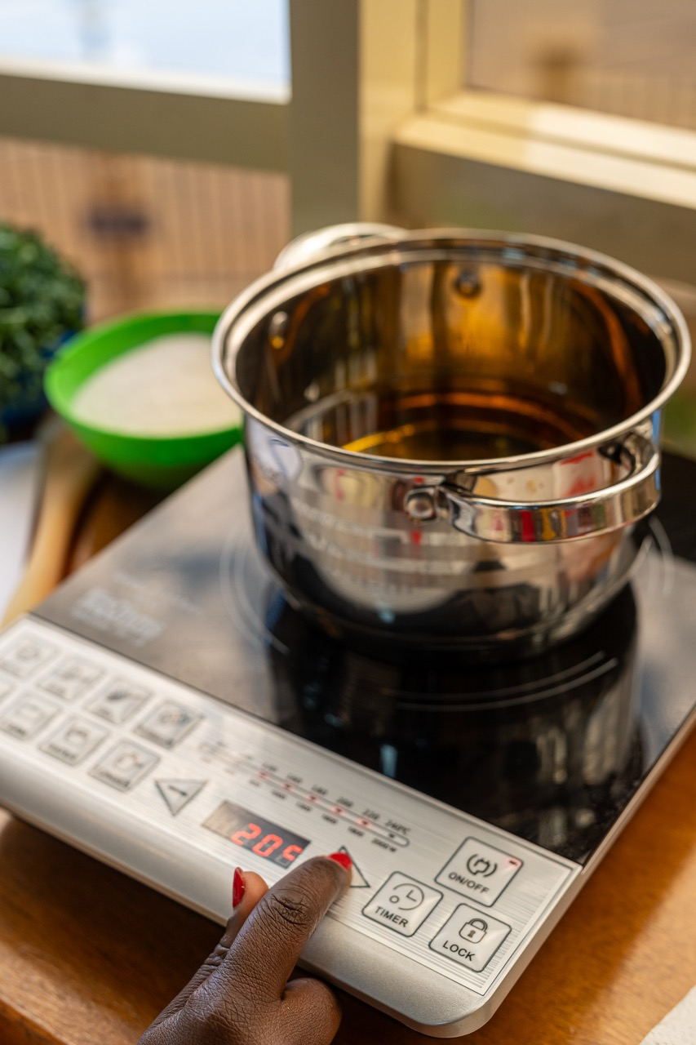
Components of the Competition
Rigorous laboratory testing according to the international and relevant national standards for Induction Cooktops, conducted by an ISO- accredited test laboratory.
Real world user testing in households, to evaluate usability, in-situ performance and overall user experience in Ghana and Indonesia. Also conduct indoor air quality testing
Judging by panel of sector experts, using robust, transparent evaluation criteria and input from market and technology experts
$100,000 in cash prizes awarded to top performing products across categories and publication of Buyer’s Guide

Slide 5
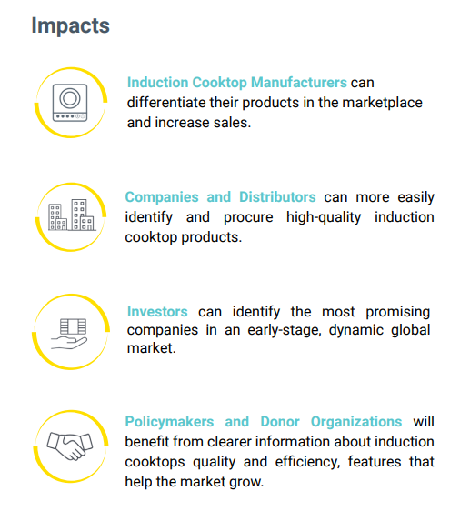
Why participate
Manufacturers, suppliers, and distributors of Induction Cooktops are eligible to participate
Inclusion in the Global LEAP Induction Cooktops Buyer’s Guide and featured in VeraSol’s Product Database
Inclusion in Global LEAP- sponsored communications to promote Competition Winners and Finalists and raise consumer awareness about high –quality Induction Cooktops
Tap into MECS, EforA, and CLASP networks to access business development and partnership opportunities

Slide 6
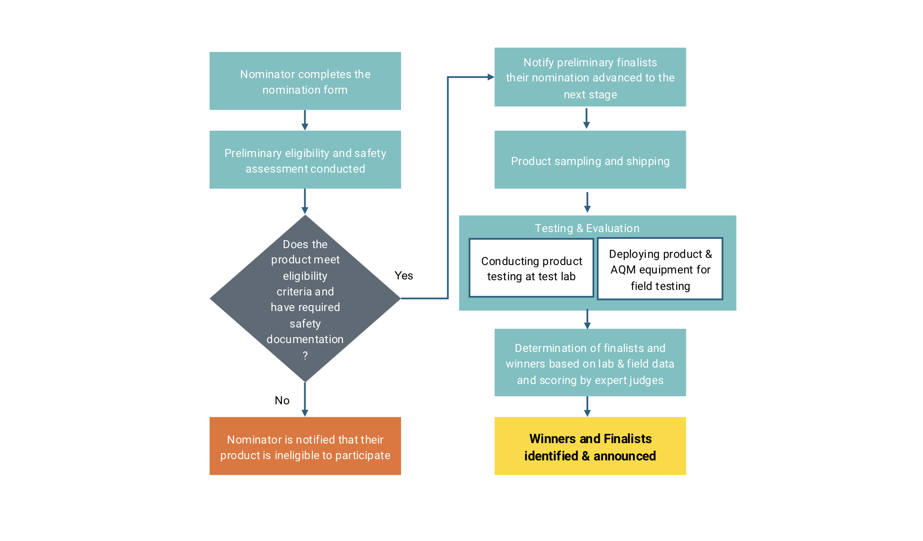
Competition Process

Slide 7
Eligibility Criteria (General and Technical)
Commercially available portable induction cooktop.
AC, DC or Hybrid powered
Compliance with IEC 60335-2-36:2021
NB: For importation into the Competition markets, compliance with national standards is required.
Indonesian Standard SNI IEC 60335-2-6:2010
Ghanian Standard - GS IEC 60335-1:2010 for Safety of Household and Similar Electrical Cooking Appliances.
Include at least a one (1) year manufacturer warranty and OR other after-sales support services
Be available for purchase from authorized suppliers or outlets in Ghana and Indonesia OR can be imported into these markets.
Be packaged and sold with safe operating instructions; and
Not knowingly be in violation of another’s intellectual property.

Slide 8
Nomination process
Nomination Window Timeline:
Opens 18th November – closes 12th December 2025
Nominating a product
Read the Terms and Condition Document
Proceed to Nominate on online Form
Contact Information
Who should I Contact with Questions? globalleap@efficiencyforaccess.org
Nomination is free.
If products do not meet safety requirements for Ghana or Indonesia, nominators must provide 2 test samples for initial lab testing.
The Nominator will bear the cost of the safety testing.
Nominators who need their products tested must contact the Administrator at: globalleap@efficiencyforaccess.org

Slide 9
Evaluation process
Points of Evaluation | Nomination | Laboratory | Determining Winners/ Finalist
Evaluation Factors | Eligibility and initial safety requirements | Safety Quality & Durability Energy Performance | Energy Performance Service Delivery Usability Value for Money
Data Sources | Documents and information submitted during Nomination | Laboratory | Combined laboratory and field
People Responsible | Global LEAP Admin team | Identified Lab partner | Panel of expert judges

Slide 10
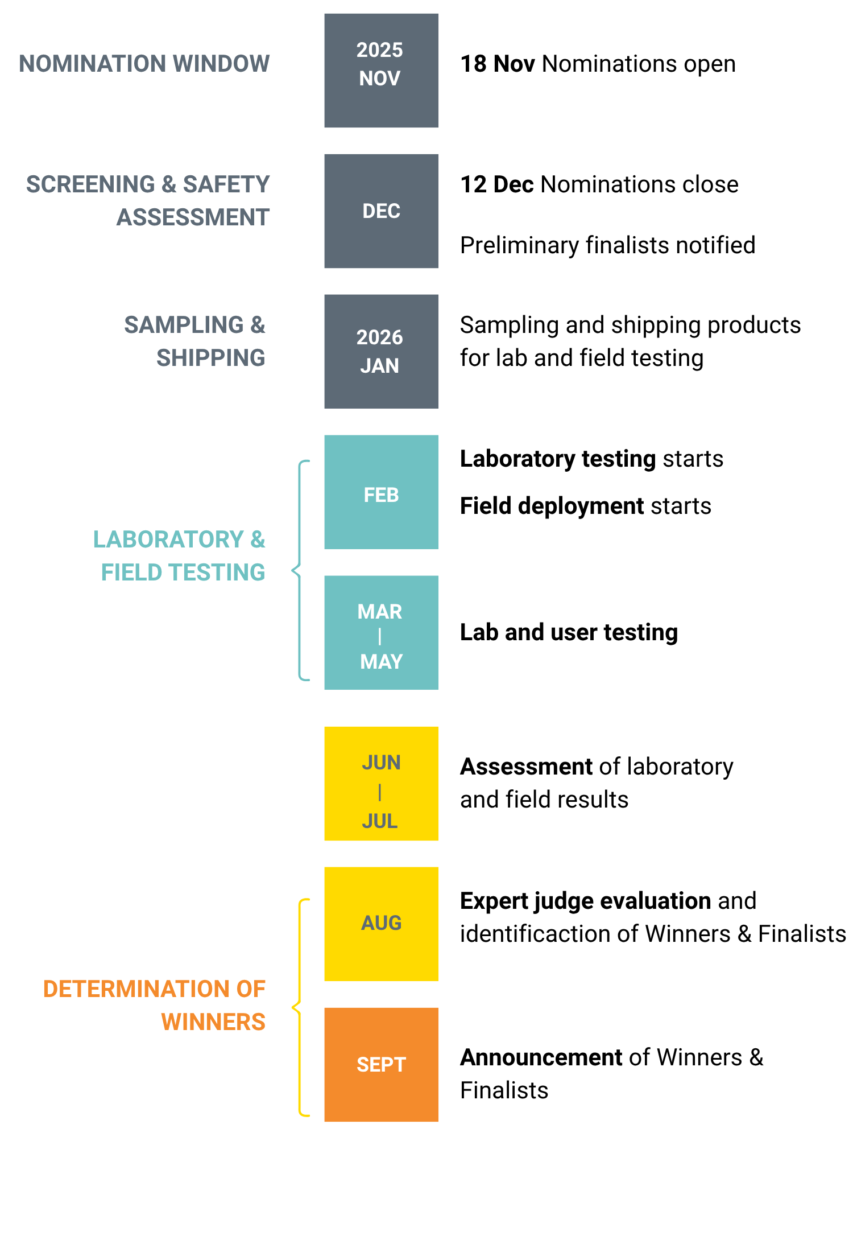
Competition Timeline

Slide 11



Any Questions? Thank you!

