Slide 1





Global LEAP Awards Competition for Solar Generators
Informational Webinar Session
15 October 2025

Slide 2
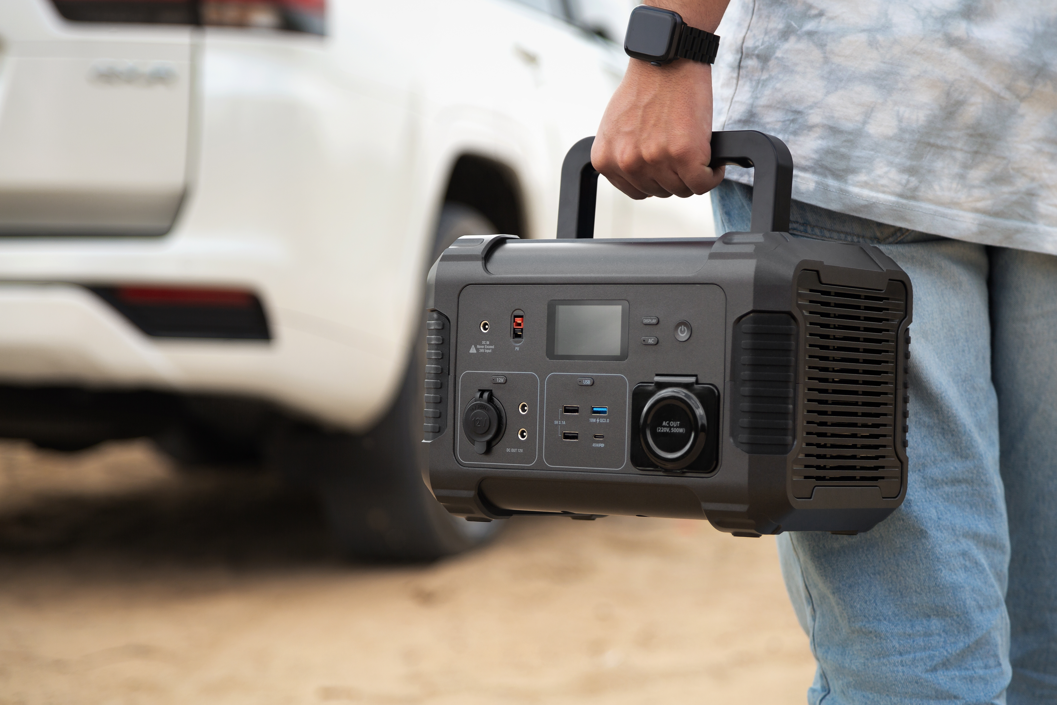


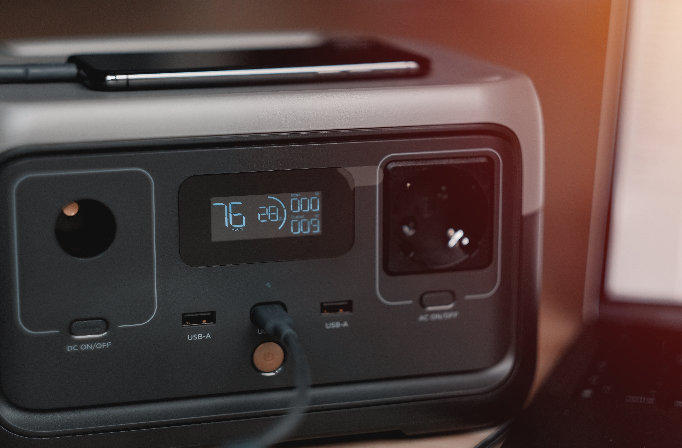
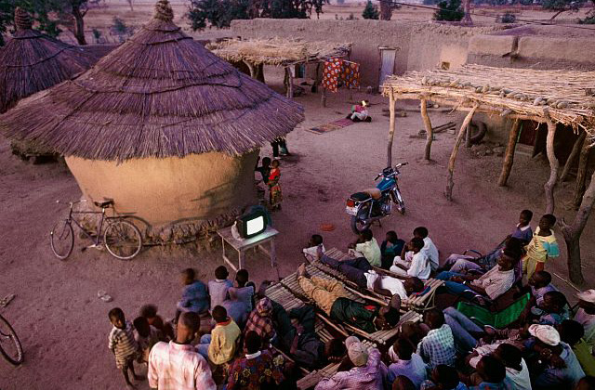
Content
Competition Overview
Main Competition Components
Who and Why Participate?
Competition Process
Definition of Solar Generators
Eligibility Criteria (General and Technical)
Required documentation
Product Categories
Nomination Process
Evaluation Process
Timelines
Q&A

Slide 3
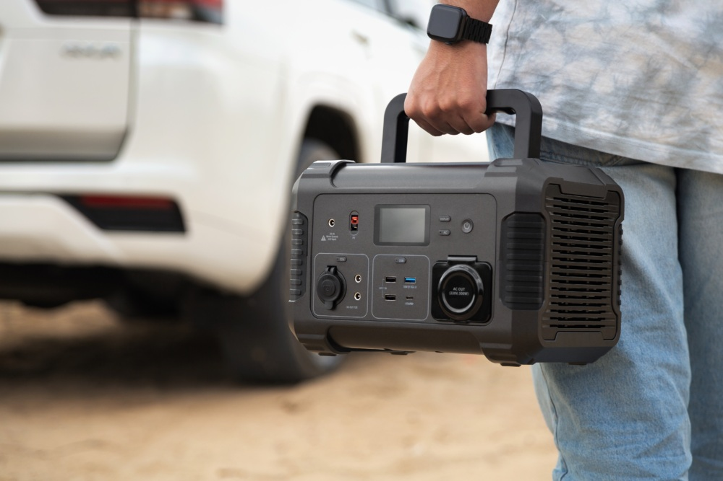
Competition Overview
The Global LEAP Awards is an international Competition that identifies and promoted world’s best , most energy –efficient appliances and equipment intended for use in the energy constrained settings.
The Solar Generator Competition aims to identify the best solar generators currently available, based on safety, performance, ease of use and value for money.
Notes:
It is funded by ZE-Gen. ZE-Gen is a collaborative initiative by The Carbon Trust and Innovate UK, with funding from the IKEA Foundation and UK Government via the Transforming Energy Access platform.

Slide 4
Components for the Competition
Rigorous laboratory testing according to the Solar Generator Test Method developed through VeraSol and conducted by an ISO- accredited test laboratory.
Real world user testing in households, business and institutions as applicable, to evaluate usability, in-situ performance and overall user experience ( country : Nigeria)
Judging by panel of sector experts, using robust, transparent evaluation criteria and input from market and technology experts
$100,000 in cash prizes awarded to top performing products across categories and publication of Buyer’s Guide

Slide 5
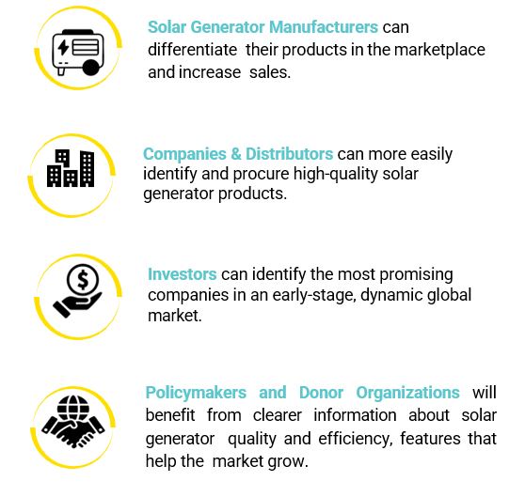
Why Participate ?
Manufacturers, designers, or associated distributors of solar generators are eligible to participate
Inclusion in the Global LEAP Solar Generator Competition Buyer’s Guide and featured in VeraSol’s Product Database.
Inclusion in Global LEAP-sponsored communications to promote Competition Winners and Finalists and raise consumer awareness about high-quality solar generators.
Tap into the ZE-Gen and Transforming Energy Access (TEA) networks to access business development and partnership opportunities

Slide 6
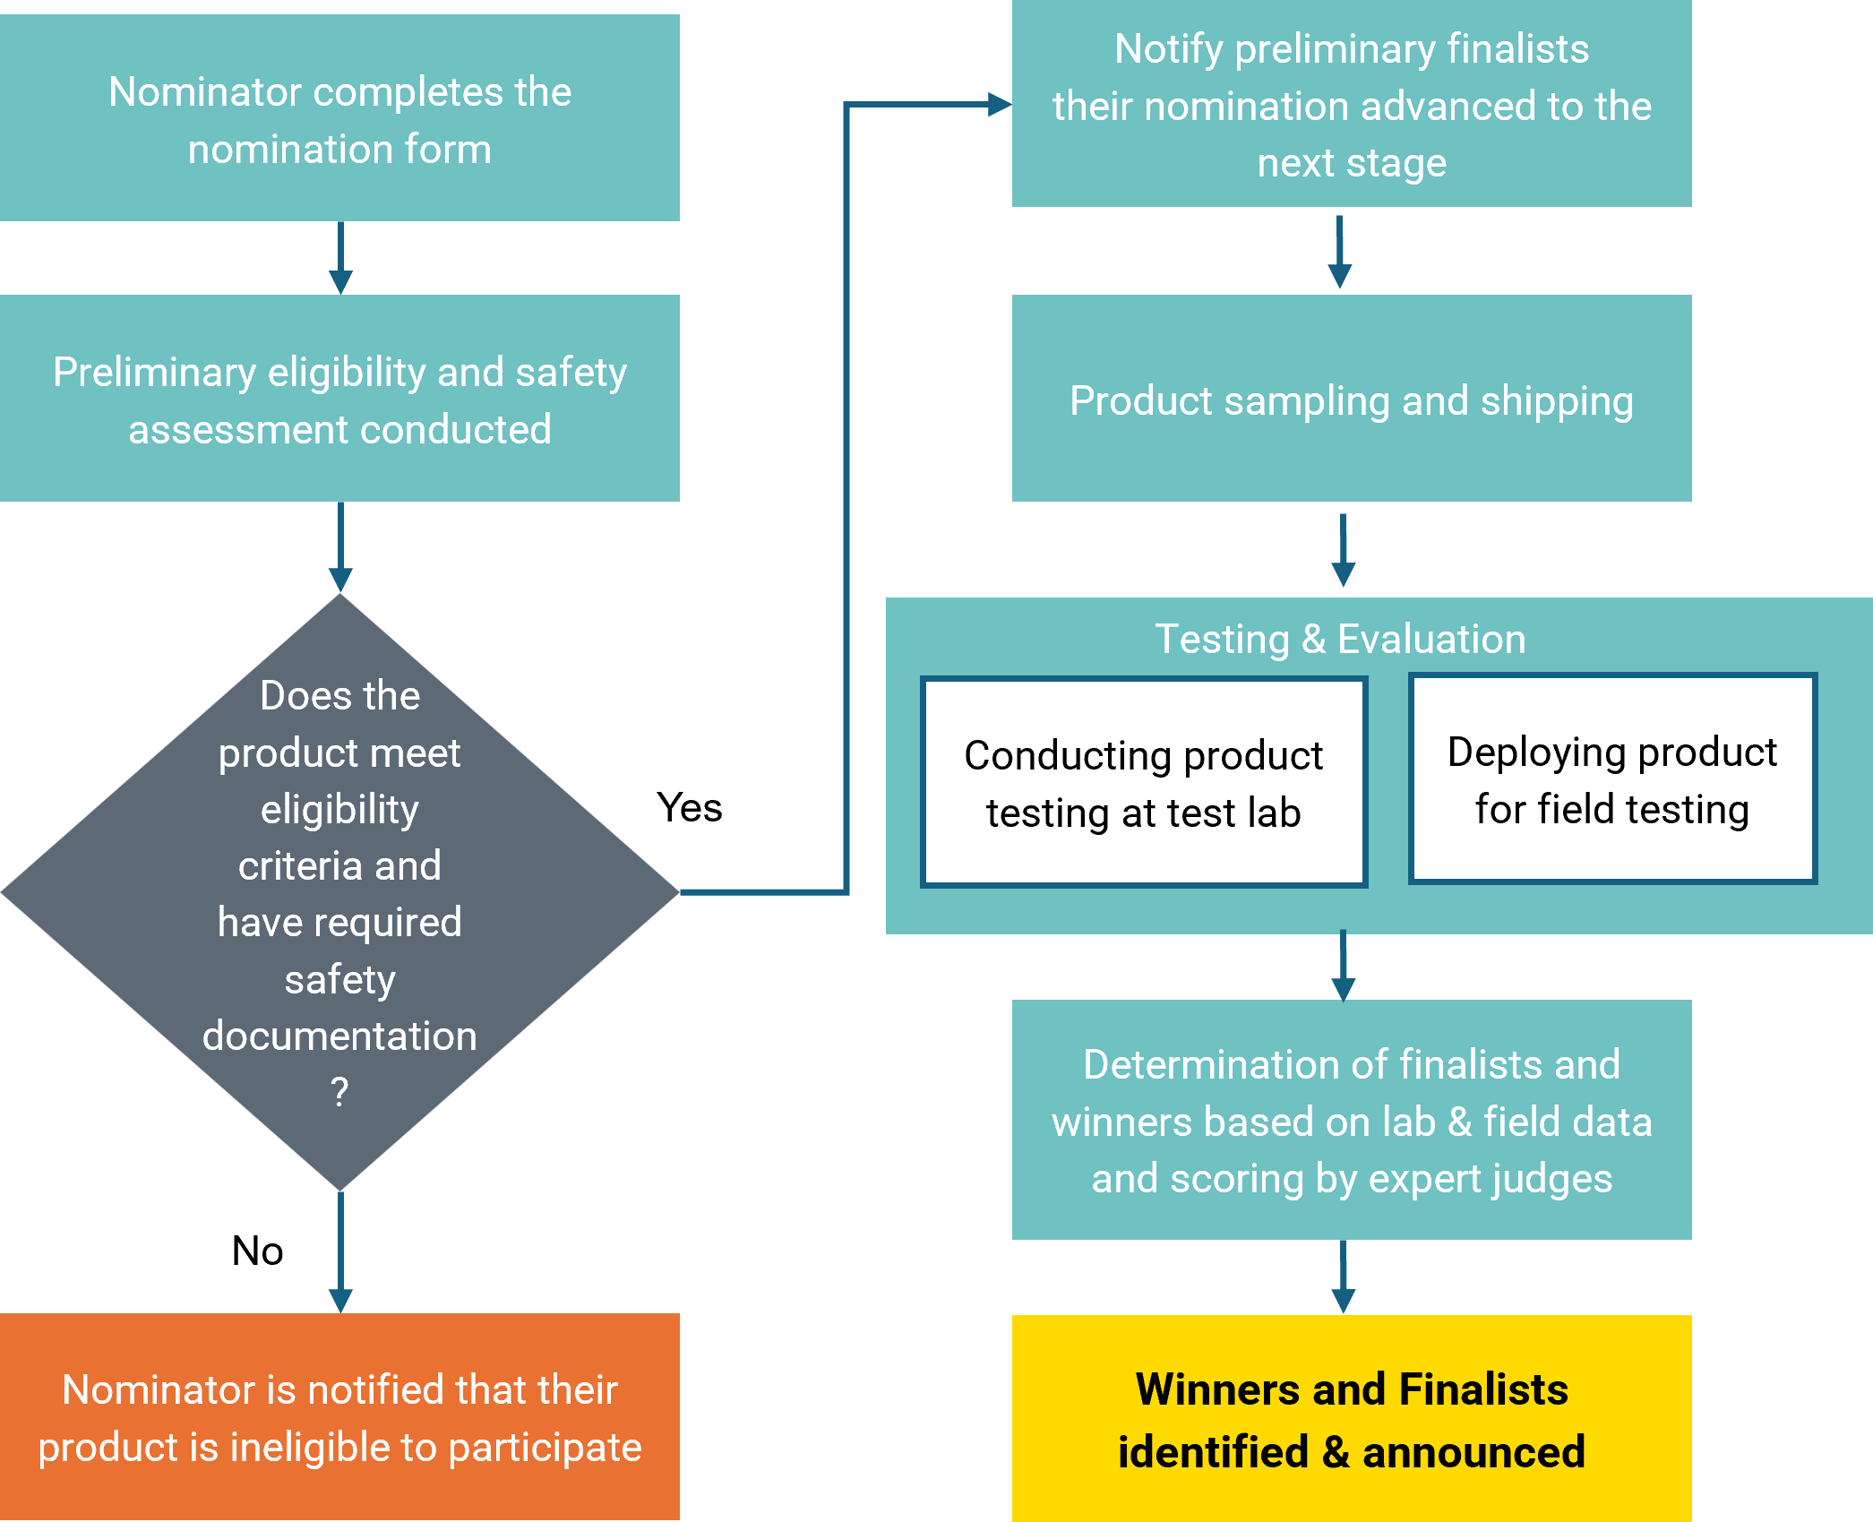
Competition Process

Slide 7
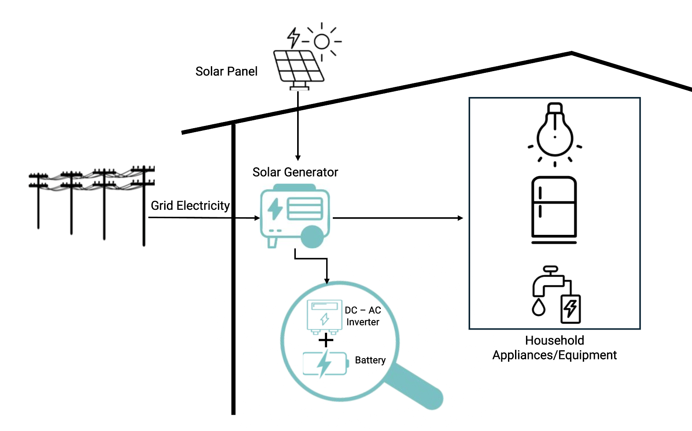
Solar Generator Definition
A solar generator is a renewable energy system that receives power from a solar module, stores it in a battery, and uses an inverter to supply AC or DC electricity
Other common terms often used to describe this technology include “solar inverter,” “zero-emission generator,” “AC solar home system,” and “power station.”
Notes:
Some systems may also allow for charging from the electrical grid; however, they are not intended to be fully grid-dependent—they can be grid charged, but not purely charged by grid.
The product is designed to power various types of electrical devices and equipment, such as household appliances, light commercial equipment, and agricultural processing machines.

Slide 8
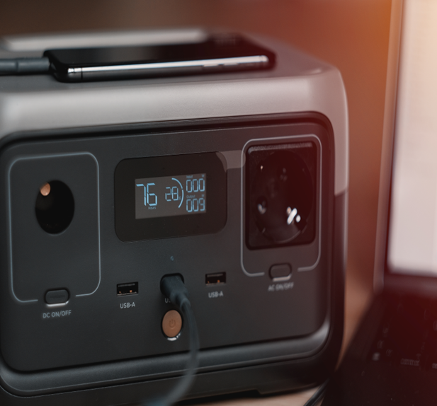
Eligibility Criteria
General Criteria e.g.,
Commercially available solar generator, i.e., no prototypes
Capable of powering typical electrical loads required by household and small commercial users
Be deployable and available for field evaluation by Administrator or its designee in Nigeria by 15 January 2026
Technical Criteria e.g.,
Power input: PV input mandatory [Product may be sold with or without PV module(s)], AC input optional
Power output: AC output mandatory, DC output optional, single-phase output only
Component size limits
Notes:
Systems intended exclusively for powering a single-purpose device (such as an e-bike) are not eligible
Key components of the solar generator (i.e., battery, charge controller and inverter) must be preconfigured and sold together as a kit
Must include user manual and consumer-facing warranty policy
Not knowingly in violation of another’s intellectual property
Products operating at 120 V, 60 Hz may be considered if they are specifically designed for countries included in the scope of the Competition.
No grid interactive systems, i.e., systems that feed power back into the grid

Slide 9
Required Documentation
Some of the required documents to participate in the competition include:
IEC 62109 – 1- Certification
IEC 62109 – 2- Certification
Documentation required for the Initial Safety Assessment
Please see the detailed required documents checklist on the webpage
Notes:
Specification sheet(s) providing details about the Product’s key components, system technical data and relevant performance information
IEC 61427-1 (Note that if this is submitted the battery durability test and requirements can be waived.)
Product user manual, including safety instructions for end-users
Photograph(s) of the Product
Documentation of the consumer-facing Product warranty

Slide 10
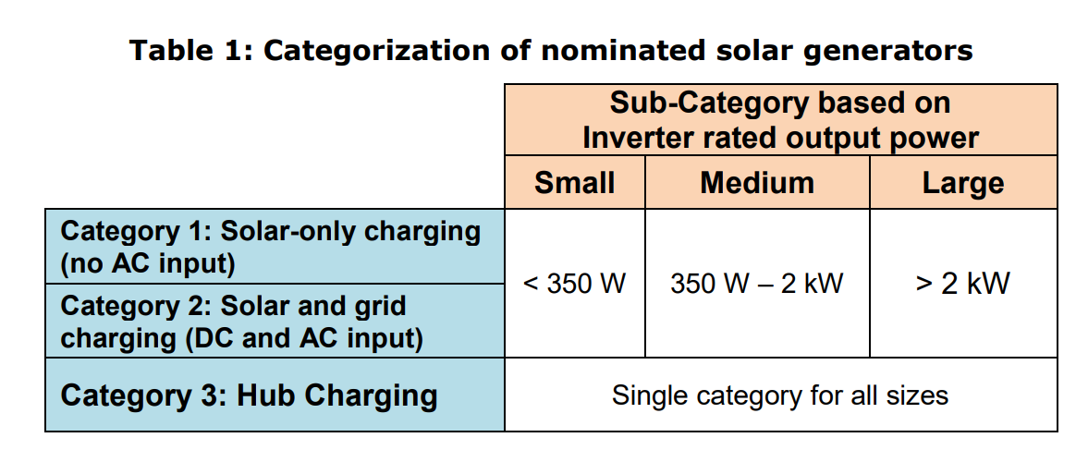
Product Categories

Slide 11
Nomination Process
Nomination Window Timeline:
Opens 8 October 2025 – closes 29 October 2025
Nominating a product
Read the Terms and Condition Document
Review the Required Document Checklist
Proceed to Nominate on online Form
Contact Information
Who should I Contact with Questions?
globalleap@efficiencyforaccess.org
Is there a fee to participate?
Online submission of Nomination Forms is free.
Nominators are responsible for covering the costs of laboratory testing, Product samples, random sampling, and shipping Product samples to the laboratory and field evaluation location. Funding will be available to cover a portion of these costs.

Slide 12

Evaluation Process
Points of Evaluation | Nomination | Laboratory | Determining Winners/ Finalist
Evaluation Factors | Eligibility and initial safety requirements | Safety Quality & Durability Energy Performance Consumer protection | Quality & Durability Energy Performance Energy Cost-Effectiveness Usability Innovation
Data Sources | Documents and information submitted during Nomination | Laboratory | Combined laboratory and field
People Responsible | Global LEAP Admin team | Identified Lab partner | Panel of expert judges
Notes:
Laboratory testing will evaluate four key areas: • Safety – Product is evaluated to ensure it is safe for use by consumers and installers (as applicable) • Quality & Durability – Visual inspection, component durability testing, and battery storage tests are conducted to evaluate the Product’s overall build quality and durability • Energy Performance – Product charging and discharging is measured to characterize the delivery of energy services to the end user • Consumer Protection – Product information, warranty coverage, and performance claims are evaluated to verify marketing accuracy and determine the level of consumer protection

Slide 13
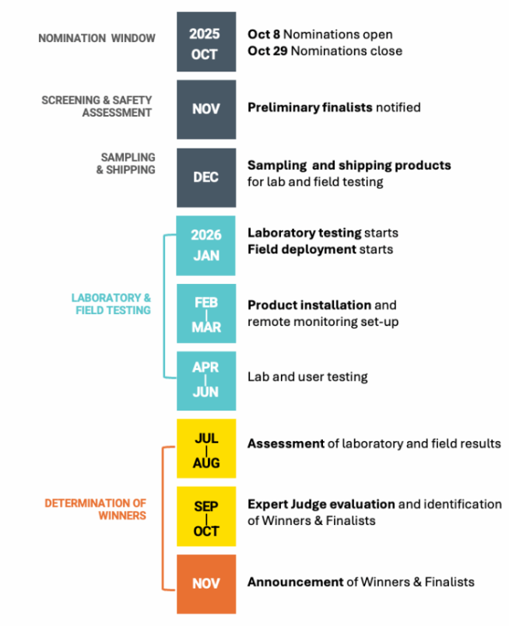
Competition Timeline

Slide 14

Thank you!
Any questions?

